Slide 1
breakout host
Notes:
PRAYER

Slide 2
Notes:
I am so excited that we are able to join thousands of Catholics all over the world in this moment of praying, listening and sharing with each other!

Slide 3
What will we cover in this session?
What is the Synod and Purpose
Resources
Prayer-Centered Listening Sessions
Small Group Management
Virtual Prayer-Centered Listening Sessions

Slide 4
What is the Synod and Purpose

Slide 5
The whole Church is united, invoking the Holy Spirit for inspiration and guidance
We are all invited to get back to the roots of the Church, where the first Christians gathered to pray, to celebrate the Eucharist and to dialogue with each other
Notes:
It is a moment where the whole Church is united, invoking the Holy Spirit for inspiration and guidance.
We are all invited to join the Bishops and the Pope in this effort to get back to the roots of the Church, where the first Christians gathered to pray, to celebrate the Eucharist and to dialogue with each other about their joys, challenges and about how to live their lives as disciples following Christ and building his Church.

Slide 6
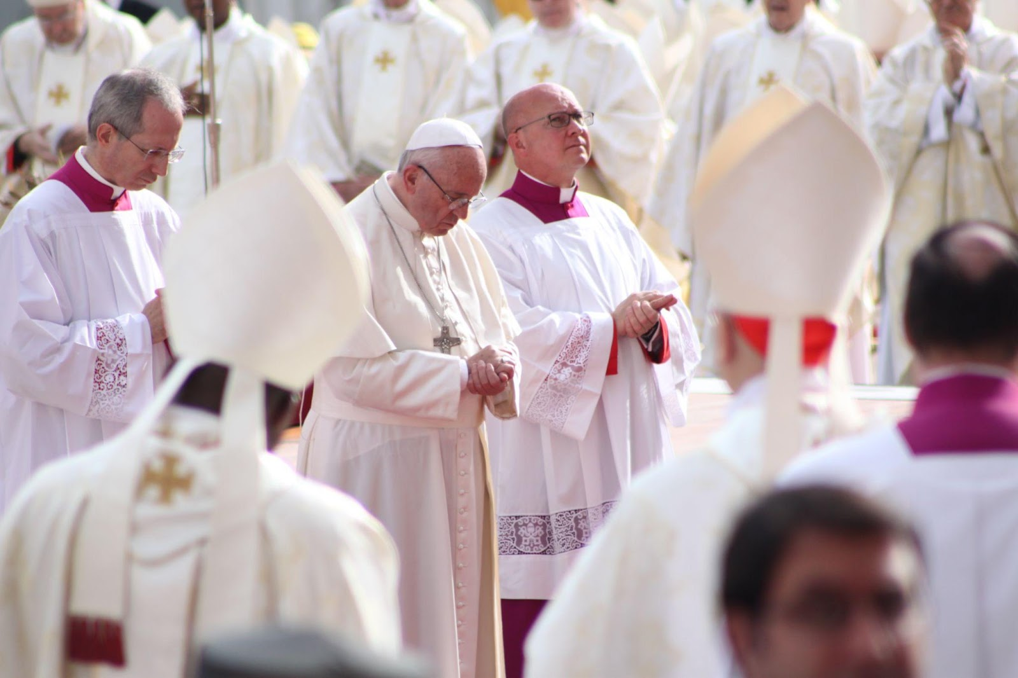
Notes:
The Bishops have gathered frequently in meetings called Synods since Pope Paul the VI instituted the Synod of Bishops in 1965, though synods have been part of the Church’s life from her beginning. Under Pope Francis, we’ve had four Synods: two Synods on the Family, a Synod on the Youth, and a Synod on the Amazonia.

Slide 7
Notes:
We are invited now to a Synod on Synodality, (slide 5- synod logo) which is basically to ponder how are we gathering together and how are we walking or journeying together as brothers and sisters in Christ. This is a process of two years, with a diocesan phase, a national and continental phase, and finally the 2023 Synod of Bishops gathering.
This is a crucial moment in the world and in our Church.

Slide 8
Together, we are emerging from a crisis which the whole world together has lived in the past 2 and a half years
Notes:
Together, we are emerging from a crisis which the whole world together has lived in the past 2 and a half years: a world pandemic, divisions, anxiety, deep disagreement. We know that bridges have been broken, and we are still trying to understand the effects in our Iives, the lives of our families and children and of course in our Church and in the faith of our people. This synod is an opportunity to rebuild those bridges of trust.

Slide 9
To a huge problem…..
A huge response!
Notes:
Before we proceed any further, I would then want to stress what the synod is and what the synod is not.

Slide 10
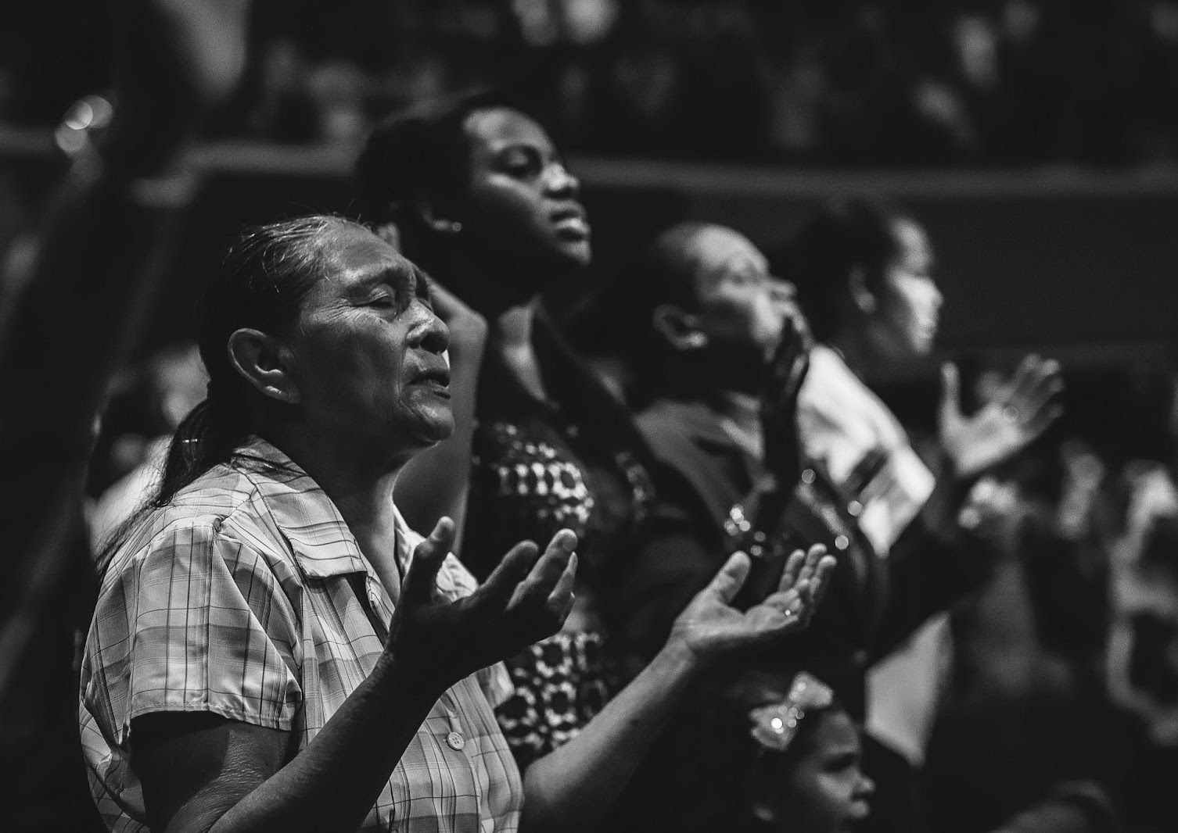
What the Synod is …
About praying and listening to the Holy Sprit, and each other, in dialogue, friendship and community life.
This Synod is not about changing doctrine or church structures, but rather encountering each other as brothers and sisters in Christ in a post-pandemic world.
What the Synod is NOT…
Notes:
This is an opportunity to gather with the same accord. The process started at the same time all over the world, in each of the 3,200 dioceses, including our own,

Slide 11
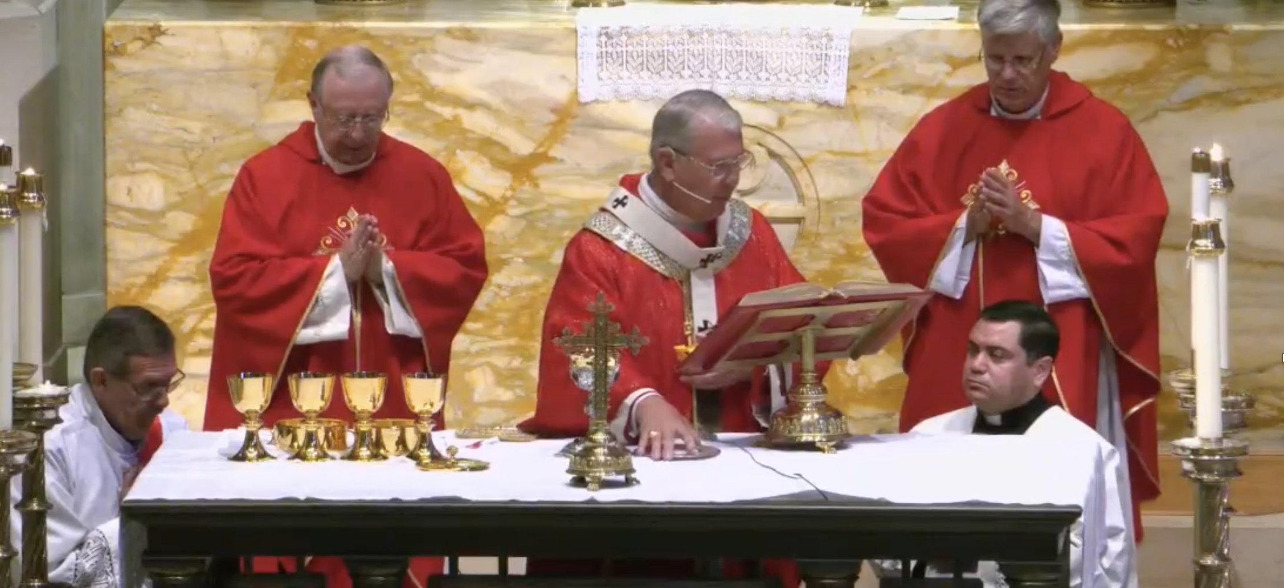
Notes:
with the celebration of a Mass on October 17.

Slide 12
Resources

Slide 13
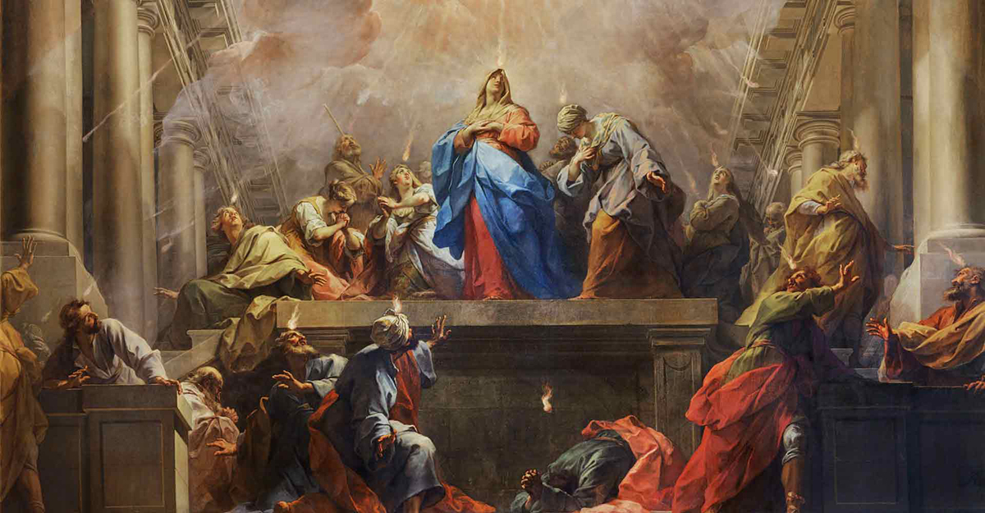
PRAYER…
Notes:
The Vatican has given us guidelines, uniting all participants in invoking the Holy Spirit

Slide 14
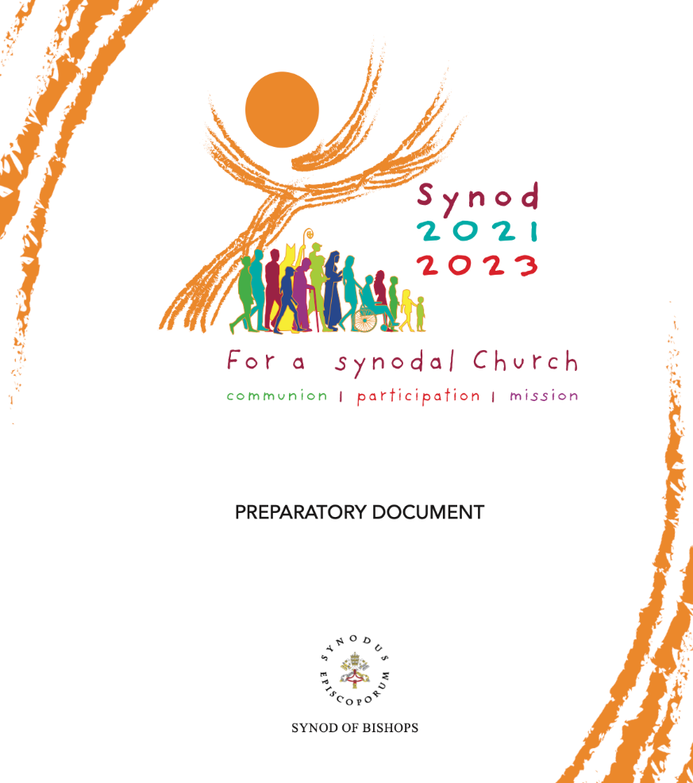
https://www.synod.va
Notes:
lots of materials, including 2 very complete documents, helping us to understand the Synod and presenting some advice into listening processes at the local level. They suggest 10 topics to ponder and lots of details, a logo that expresses us as a universal community under Jesus Christ

Slide 15
https://archatl.com/synod/
Notes:
for the process, particular sessions, and a simple reproducible kit for all participants. We call it the Parish tool kit, but it can also be used by schools, campus ministries, and other groups. We have also selected 3 of the10 topics..

Slide 16
Archdiocesan Phase Timeline
Extended until late April
Preparing People of God
Consultations with the People of God
Diocesan Report
11/28 Consultation Phase Begins
4/30 Local Reports to Archdiocese
6/30 Report to USCCB due
1/18-25 Week of Christian Unity
6/17-18 Eucharistic Congress
10/17 Launch
12/25 Christmas
3/2 Ash Wednesday
4/17
Easter
6/5
Pentecost
October
November
December
January
February
March
April
May
June
Local Consultations
Pre-Synod Meeting
Preaching, Catechesis, and Prayer
Regional Listening Sessions
Survey

Slide 17
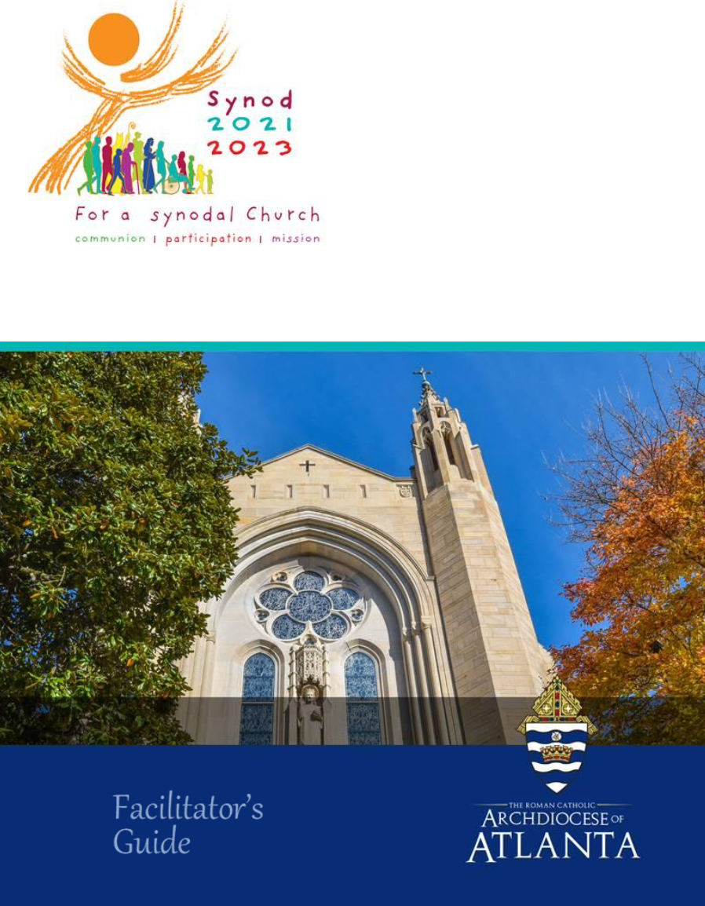
Facilitator’s Guide
Notes:
This training is meant specifically for parish, school, or group leaders to assist you in facilitating listening sessions. This information is also outlined in the Facilitator Guide found on the Archdiocesan website.
You can run a gathering in many ways: it could be a large community gathering, or a conversation between two people. It is likely that a small group format would be most successful to elicit sharing in fellowship and intimacy.
Throughout this synodal process, special emphasis is being given to prayer and listening to the Holy Spirit, and to share what each and every one of us heard in our prayer. So we are referring to these sessions as Prayer-Centered Listening Sessions

Slide 18
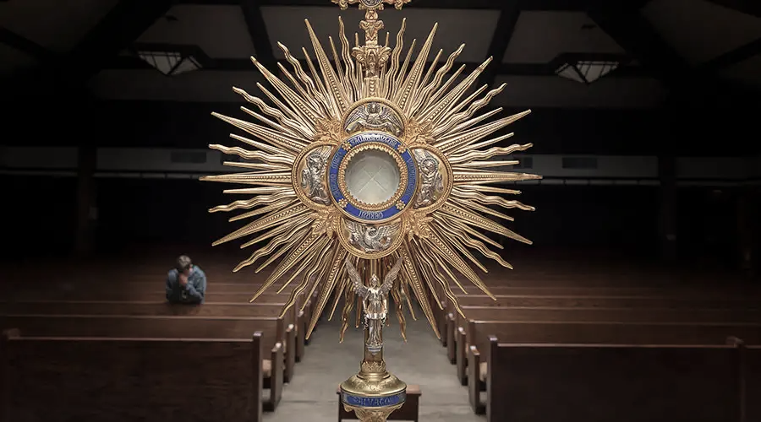
Prayer-Centered
Listening Sessions

Slide 19
This is a great moment to reach out and invite people to meet us, to come back, to pray with us and to dialogue. We suggest you invite broadly all parishioners, and encourage them to bring friends, neighbors, anyone, not only Catholics.
Remember, building bridges…. In the light of the Holy Spirit, creating opportunities for the Sprit to work in us and in others.

Slide 20
Session Suggestion
One day
3.15 hrs.
3 days
90 mins. each
Virtual
1 hour and 15 minutes each
Notes:
We propose 2 options for facilitating this process most effectively:
A one-day option, which can be run multiple times, and be done in person or virtually. You could host a whole day retreat centered on prayer, listening, and reflection. However, understanding people’s busy lives we have condensed it to a 3 and a half hour meeting.
We are also offering guidelines for 3 sequenced meetings of 90 minutes each, which could be done at night or mornings, for different audiences and groups in the parish.
Some final comments for virtual sessions will also be provided, given the interest in offering the option.

Slide 21
General Framework
Hospitality
Opening Prayer
Introduction & participant ground rules
Individual prayer/ Listening to the Holy Spirit
Listening to each other and sharing
Conclusion and closing prayer
Notes:
For the prayer centered listening session itself, both options – one day or 3 consecutive weeks – have a similar framework:

Slide 22
Detailed Framework and Script
One day
p. 10-15
3 days
p. 19-30
Notes:
We provide you with a detailed framework and script, so you have everything you need to facilitate a session, including the words to read if you wish, and we have very specific suggestions for each part especially to help you administer the time.

Slide 23
Session Team
Facilitator
MC
Table hosts (1x6)
Note takers
Greeters
Food servers
Intercessors
AV person
Notes:
With any of these models, we propose a team of people, Slide 15 that will include an MC/facilitator (to direct traffic and the session sequence); if you opt for small group and have tables in your parish hall, then table hosts, some greeters and note takers at the table to gather thoughts – in total confidentiality and anonymity.

Slide 24
Example of a Session Team
Facilitator (session administrator)
Table or small group
Host or moderator
Note taker
6-8 guests
Master of Ceremonies
Table or small group
Host or moderator
Note taker
6-8 guests
Table or small group
Host or moderator
Note taker
6-8 guests
Table or small group
Host or moderator
Note taker
6-8 guests
If possible, intercessors while the session is undergoing
Greeters, food servers, AV/tech person

Slide 25
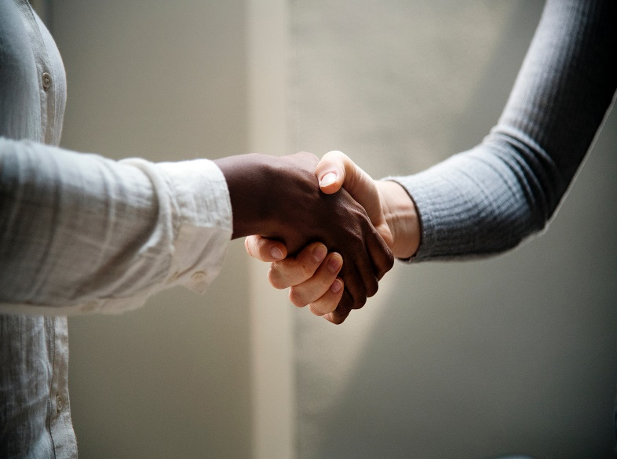
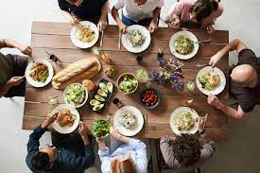
The session...
Hospitality
Optional ~30 mins
Notes:
I recommend excelling in hospitality during these sessions; take into account that there might be people coming in for the first time, so place greeters, the naturally happy people, to ensure a welcoming environment.
Offer some food and drink. In these times of face coverings is challenging, but please, if you can have a huge pot of oatmeal for the mornings or lentil soup, something light, not expensive for you, but that will allow an opportunity for fellowship at the tables, it is a great icebreaker!
Provide name tags, so everyone gets to know each other by name.

Slide 26
Opening Prayer
~ 10 minutes
Notes:
To center and focus the session in a proper way, open with prayer, please check your Adsumus Sanctus Spiritu prayer, and join the whole world in this invocation to the Spirit.

Slide 27
Introduction & participant ground rules
Prayerful Communication Guidelines & Participant Ground Rules (p. 34)
~ 10 minutes
Notes:
After a brief introduction of the session, what to expect, it is very important to review the communication guidelines and the participant ground rules on p. 34.
We recommend that you print your preselected questions (we will talk more about them next), and ask people to ponder them in silence, go to the chapel, offer Adoration if possible, and then gather again at the table for sharing.

Slide 28
Listening to the Holy Spirit
Each guest has a copy of the question/theme to ponder
One day
25 minutes
3 days
20 minutes
Notes:
*** if you have prayer groups at the church, consider asking other parishioners if they would be willing to be in the Chapel as intercessors or guardians while the session is going.

Slide 29
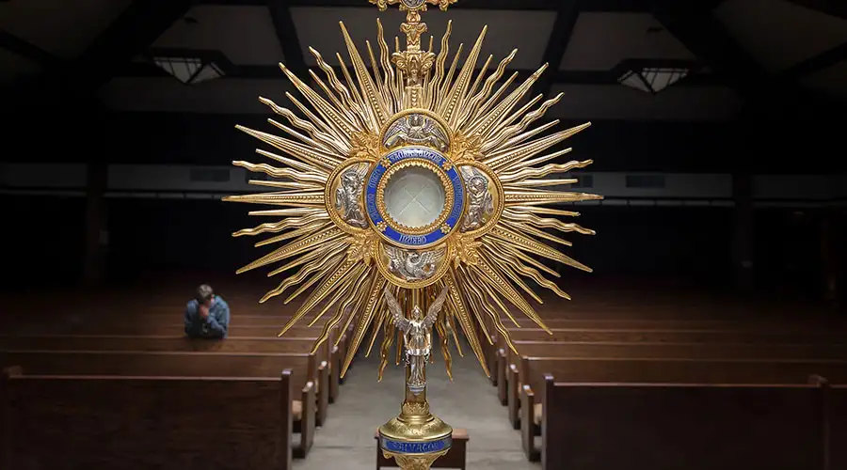
Why so much emphasis on prayer?

Slide 30
Listening to each other and sharing
The longest part
One day
2hrs 15 mins
3 days
40 minutes
Notes:
The sharing and listening time is a crucial part of the process, so we want to ask you to review the material really well with your table hosts. We have on page. XXX some thoughts on what to consider when choosing host and the rules for sharing. We will review this at the end of this session.

Slide 31
The Questions/topics
for the Prayer-Centered
listening sessions
Notes:
Please note that this is a suggestion, you can even select from these or use other ones, according to your context. It is important to remind people that it’s been clear in the Vatican documents that the intention is NOT to change doctrine or fundamental church structures, but to have fellowship, to get together after the pandemic, to invite to something quite novel and to dialogue and identify the wounds and the dreams!

Slide 32
The Fundamental Question
Supporting Questions
Final Question

Slide 33
The Fundamental Question
How are we announcing the Gospel, “together” as a parish/community?
How is the Holy Spirit inviting our parish/community to grow in “journeying together?”
One day
25-30 min.
Week 1
35 minutes

Slide 34
Supporting Questions
(1) Listening & Discernment
(2) Co-Responsibility & Participation
(3) Prayer and Celebration
One day
90 min.
Weeks 2 and 3
~40 minutes
Notes:
These themes are to ponder on our own role in the church and an examination of ourselves as a people and as a community and a church .

Slide 35
Final Question
Hearing the voice of the Holy Spirit
One day
15-20 min.
Week 3
~20 min.

Slide 36
Additional questions
(optional)
p. 38
recommended for ecumenical sessions

Slide 37
The Small Group

Slide 38
Small Group
Table Hosts
Mental prayer
Respect
Smile
Radical kindness
Elicit equal participation
Interest
Keep time
Keep conversation going
Encourage communication guidelines
Moderate
Notes:
Again, I want to emphasize that no matter who your guests are, start with prayer, give witness to the possibility of a relationship with God and be open to the Holy Spirit. Try not to rely only on human grievances; instead keep prayer in the center of your mind the whole time the session is going on…. Ask the Sprit to guide your words and actions, and to see all with the eyes of our Creator

Slide 39
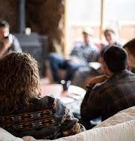
Participant Ground Rules
p. 34
P – PRAY and PONDER before and after you speak.
R – Take RESPONSIBILITY for your own thoughts
avoiding the temptation to lay blame on others
A – ALLOW others to speak and to share without correction or criticism
Y – YOU – Be attentive to your own thoughts, feelings, opinions or even prejudices.
E – Use EMPATHETIC listening and be attentive not just to words but also to feelings being expressed.
R – RESPECT every person as Jesus taught us: love one another.

Slide 40
Handling Difficult Situations
Notes:
The table host needs to be a welcoming, loving, moderator of the conversations, ensuring and guarding respect; there should be dialogue and not debate. If any pastoral situations may arise, please defer to the pastor by saying something like the following:
Thank you (the name of the person) for your contribution, let’s try to stay on topic, we can chat about this at the end of the meeting if you would like. Whether or not you are qualified to give an answer, the session is not the place for answering such questions or grievances. Be humble and vulnerable, show empathy for any suffering, and recommend speaking to your pastor or deacon. Take their number and name and give it to your coordinator, so the person can be pastorally accompanied.
It is important to be humble, and not teach or debate with the table guests; see them with love and respect, and do not judge or criticize them; try to be empathetic, but keep the discussion on the topic your pastor has chosen and keep time, so all at the table might have a chance to share.

Slide 41
Facilitating a Small Group Discussion
https://youtu.be/di6rLhZTWXE
Notes:
I just found this video produced by ascension for Bible studies, but it is very good.

Slide 42
Virtual prayer-centered listening sessions

Slide 43
Considerations
Duration: one hour to one hour-fifteen minutes max
Limit of people: 75 max
Platform: make sure you can exceed 1hr.
Distribute: participant guide ahead of time
Team: MC, breakout group hosts, notetakers, tech support
Practice, practice, practice…..

Slide 44
Structure
Hospitality – creative ideas
Opening Prayer- shorter but don’t miss it!
encourage to keep prayer environment at home
Presentation on each question
Shorter time for personal reflection
Listening Sharing
Clear rules for breakout rooms
Closing and final prayer
Repeat for each
question

Slide 45
Session Engagement
Ensure the MC/facilitator is engaged with guests from the beginning of the online session – saying hello to people, asking questions, telling jokes. Avoid the silent downtime to keep excitement and enthusiasm high.
Ensure the breakout hosts are trained and can also keep the conversation going, interrupting, managing the discussion, avoiding awkward silence….
*** if possible, team 2 people to run each group

Slide 46
Ensure Quality Discussion
Ask all guests to be on video
Ask all guests to join in a quiet environment if possible
Ask all guests to unmute during discussion. (Unless in a noisy setting). This allows for a more organic, free-flowing conversation.
Ask guests to not use green screen backgrounds to create a more natural environment.

Slide 47
Preparation
Internet Connection: Make sure you have a strong internet connection. If possible, plug directly into an ethernet cable.
Hosts should have all files and discussion questions ready, as well as access to the digital solution the church has chosen.
Know how to go to breakout rooms and back
Practice, practice, practice, practice!

Slide 48
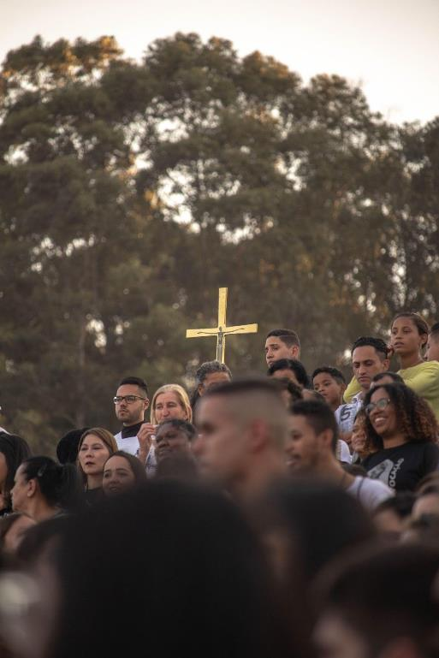
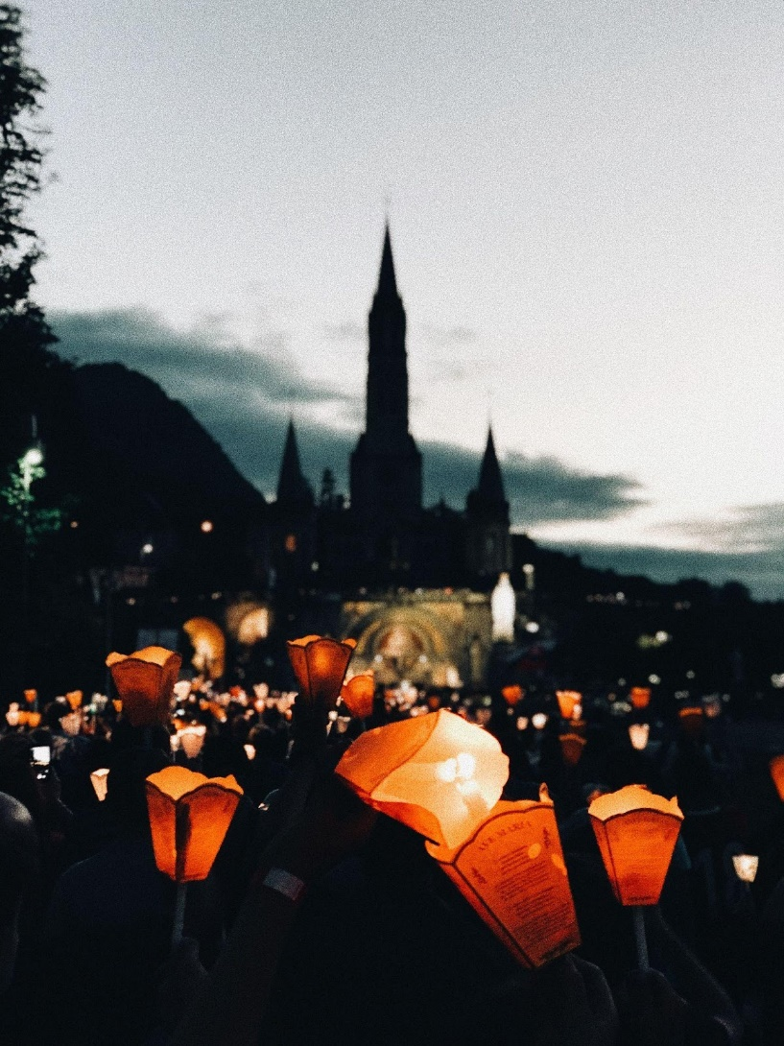
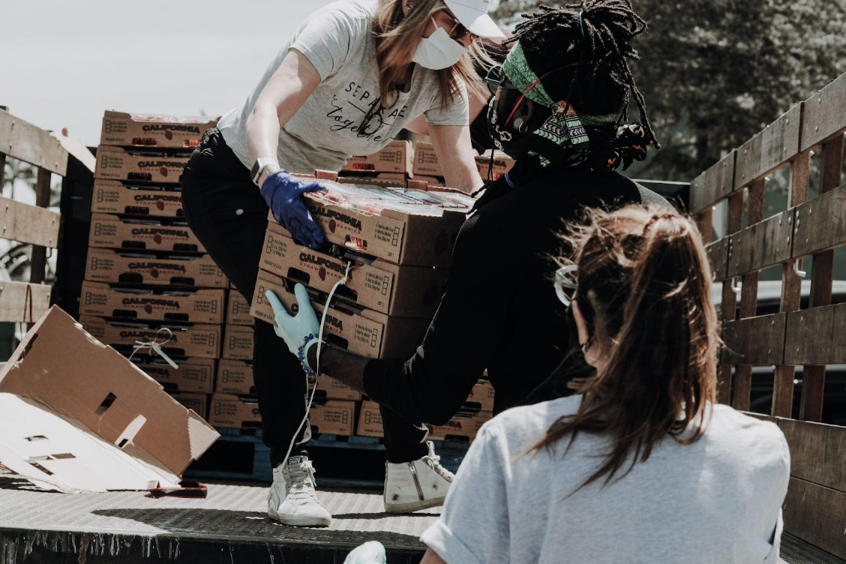
Invite to more….
Notes:
** We suggest using this opportunity to invite participants to the next step at the parish, be it a Lenten mission, a bible study, or any other gathering you think the visitor or table guests will enjoy.
If you are hosting your sessions after Ash Wednesday, you might be able to broaden you audience, and vice-versa, you can take the opportunity of the Synod gathering to invite to your Lenten programs and Holy Week and Easter liturgies and activities.

Slide 49
Notetakers
ONE parish report/summary for the Archdiocese
Notes from all groups and sessions
Notes:
Someone at the table should take notes of the topics discussed, which of course will be anonymous. The notetakers will give the notes to their facilitator, to process for the pastor and for the parish summary.

Slide 50
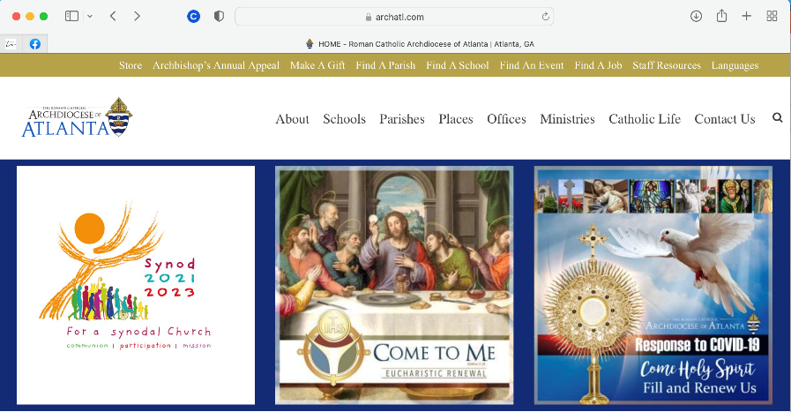
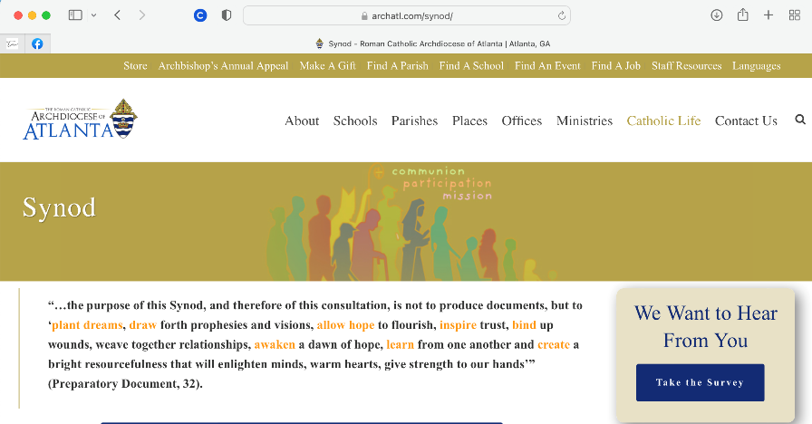
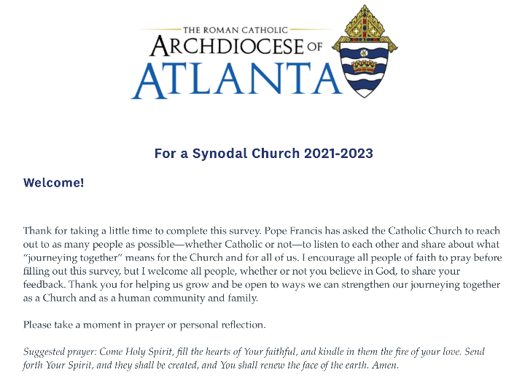
Survey
https://archatl.com/synod/
Notes:
Finally, please publicize broadly the survey….

Slide 51
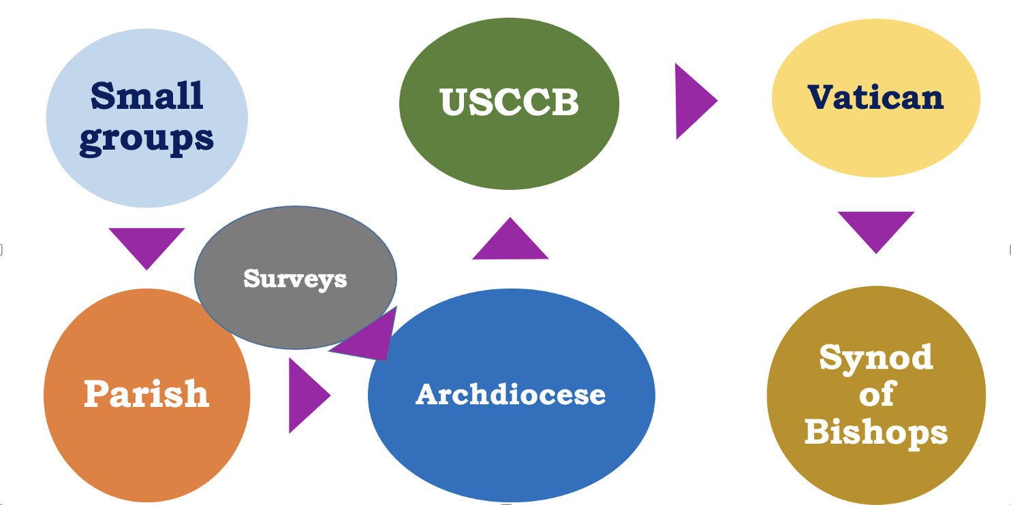
Notes:
After your prayer-centered listening session, your parish/school or group will also summarize the findings and share with the Archdiocese. Regional meetings will also happen across the archdiocese. The diocesan team will gather all regional and parish summaries, the survey results, and will create a 10 page summary to share with the USCCB. The Bishops conference in turn will create a summary of all 195+ processes in dioceses across the country, submitting the report to Rome. Continental gatherings will then occur with additional reports, leading to the final working document from the Vatican in 2023 of all that happened and the processes that were implemented with all the concerns and fruits. This will prepare for the Synod of Bishops meeting in October of 2023.

Slide 52
Monica Oppermann Evangelization Strategies Office of Evangelization & Discipleship
moppermann@archatl.com
Notes:
Let’s continue to pray for this journey! Thank you for participating in it.
Please reach out to us with any worries or particular questions.
Here is my name and address, or contact anyone else in the diocesan team at:

