Slide 1
Senior Adult Ministry Networking Call
April 18th, 2023
Welcome! Please type your name, location/parish, and role in the chat box as we gather.

Slide 2
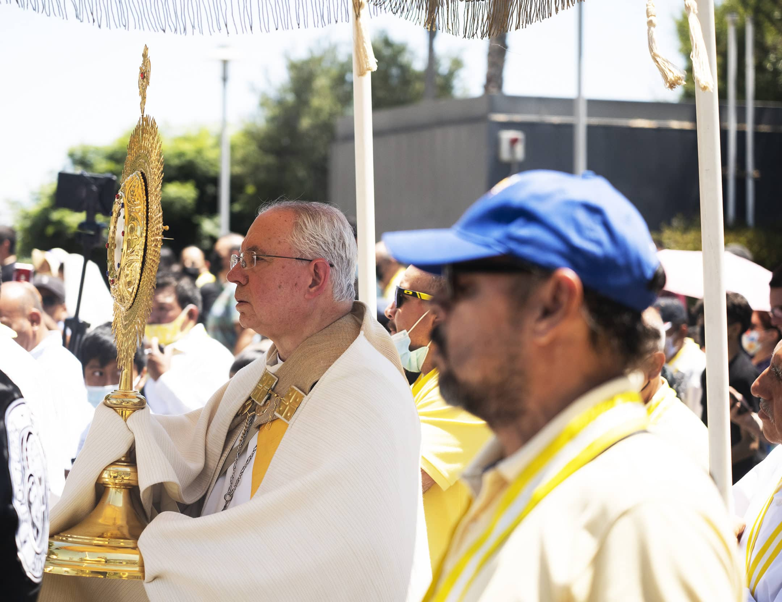
Opening Prayer
Heavenly Father,
we thank you for the gift of your Son, our Lord Jesus Christ, who promised to stay with us always, until the end of the age.
Reawaken our wonder at His presence in the Most Holy Eucharist. May our hearts burn within us as He opens the Scriptures and breaks the bread.
Give us the eyes of faith to recognize His presence in our brothers and sisters, especially in the face of the poor and the suffering.
Nourished by the Eucharist, send us forth to walk faithfully as missionary disciples, proclaiming the Gospel to every heart and extending Your kingdom to every land.
We ask this through Christ our Lord.
Amen.

Slide 3
Agenda
OED update
Eucharistic Revival: Update
Parish Year (June 11 – June 17th, 2024)
National Eucharistic Congress
RESCUE – Atlanta
Announcements/resources
Update re: in-person gathering 2023
Resources
Closing Prayer

Slide 4
Senior Adult Ministry Leadership

Slide 5
Eucharistic Revival: Parish Year (June 11 – June 17th, 2024)
archatl.com/revival/

Slide 6
Senior Adult Ministry
Leader Representative
www.eucharisticcongress.org

Slide 7
www.evangelizationatl.com/rescue

Slide 8
Other Announcements/Resources
The Peace with Dementia Rosary
Dementiarosary.com
Catholicaging.com
Support groups, free videos & articles, books, prayer cards and prints, prayer wall for intentions
Nursing Homes with Mass?
St. George’s village/Mount Vernon

Slide 9
In-Person Gathering Planning – 2023
Date?
November 16th?
Location- Chancery
Attendees
Focus?
Reflective/Retreat?
Informational?
Networking/Fellowship?
Possible Presenters/Topics
Other ideas?

Slide 10
Additional opportunities/resources?

Slide 11
Closing
Meeting notes with links to be sent ASAP to distribution list
Archives of past meetings: “Building a Network”
archatl.com/ministries-services/senior-adult-ministry/building-a-network/
Upcoming Networking Calls-
August 17, 2023, November 16, 2023, February 15, 2024
Glory Be

