Slide 1
In Pew process
2024 Archbishop’s annual appeal

Slide 2
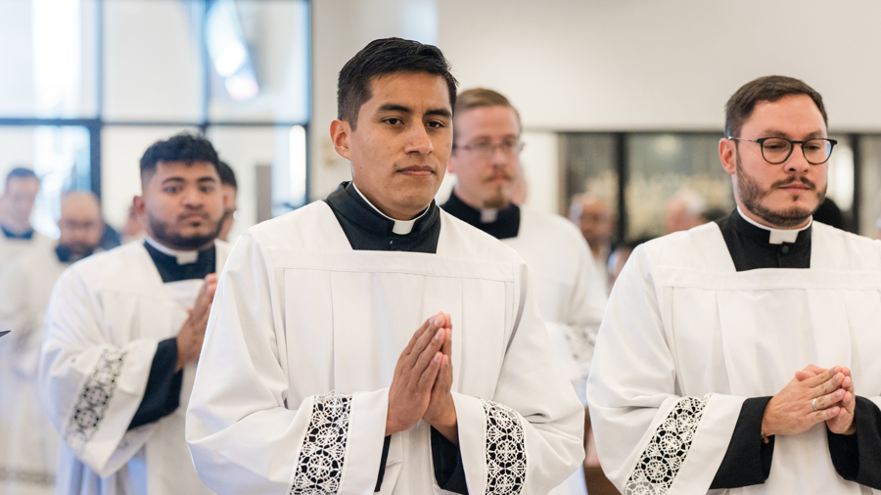
Each of us is called to share our gifts in support of the Church. We must first support our parish, then our archdiocese, and then the Church throughout the world.
The Annual Appeal of the Archdiocese of Atlanta not only funds the Programs of the archdiocese, but it also funds services that are of great help to the ministries right here in our parish.

Slide 3
Pledge Card

Slide 4

Please print your first name and your last name on the first line

Slide 5
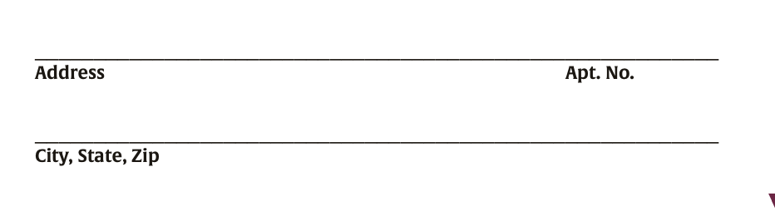
On the second line, please print your address including any unit or apartment number.
On the next line, please print your city, state, and zip code

Slide 6
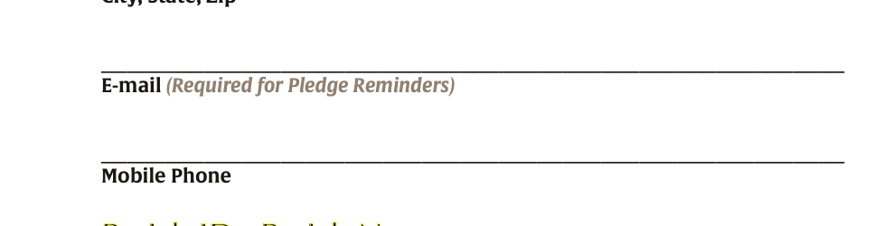
Next, please print your primary email and then below your telephone number.

Slide 7
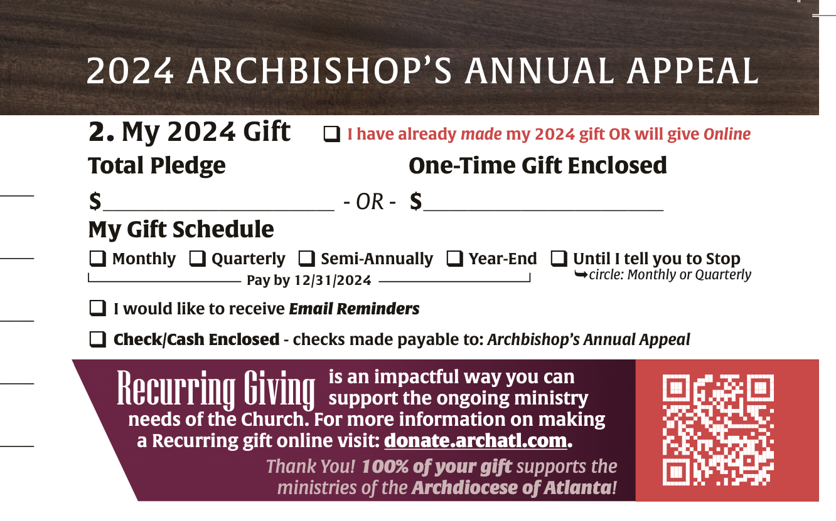
If you have already made your 2024 gift or will give online, please check the box I have already made my 2024 gift or will give online.

Slide 8
Please write in your total pledge amount on the line provided or your one-time gift that you are including today.
100

Slide 9

If you’d like to set up a recurring gift, simply check until I tell you to stop and indicate if you want to pay monthly or quarterly.
1,000

Slide 10

Please check either monthly, quarterly, semi-annually or year end according to how you’d like to pay your pledge.
1,000

Slide 11


If you would like to help us conserve paper and postage, your pledge reminders could be sent to you by email instead of in the mail. If so, please check the I would like to receive Email Reminders box and make sure your email is included under your address.
1,000

Slide 12
If you would like to make a gift today, please mark Check/Cash enclosed.
If you would like to make your payment by credit card or direct debit now please scan the QR code, or visit donate.archatl.com to make a pledge or one-time gift online.
Cash or Check
Credit or Debit

Slide 13
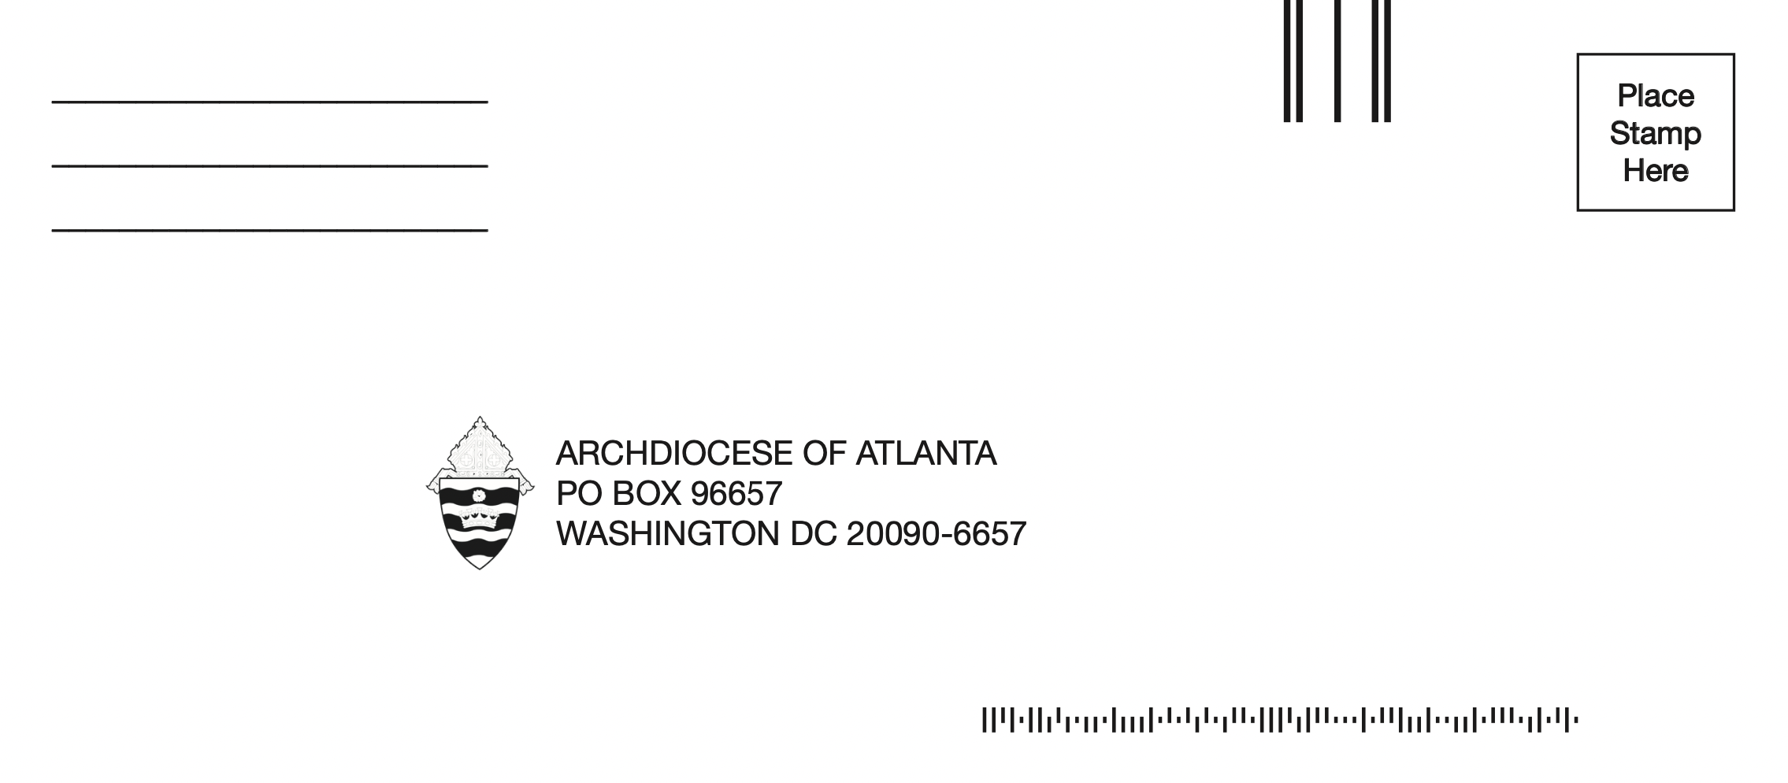
Please place your completed pledge card and donation, if you are making one today, in the envelope and seal it.
It will be sent to Moore, our Secure Gift Processing Partners in D.C., for quick processing.

Slide 14


