Slide 1
Extraordinary Ministers of Holy Communion Training

Slide 2
Jesus is truly present in the most Blessed Sacrament of the Eucharist

Slide 3
“Come Holy Spirit" Prayer
Come Holy Spirit, fill the hearts of your faithful and kindle in them the fire of your love. Send forth your Spirit, and they shall be created. And You shall renew the face of the earth. Let us pray. O, God, who by the light of the Holy Spirit, did instruct the hearts of the faithful, grant that by the same Holy Spirit we may be truly wise and ever enjoy His consolations. Through Christ Our Lord. Amen.

Slide 4
Introduction to the Eucharist
Christ’s teaching on the Eucharist by Bishop Robert Barron.

Slide 5
The Gospel of John directs us to the Real Presence John 6: 48-59
48 I am the bread of life. 49 Your ancestors ate the manna in the desert, but they died; 50 this is the bread that comes down from heaven so that one may eat it and not die. 51 I am the living bread that came down from heaven; whoever eats this bread will live forever; and the bread that I will give is my flesh for the life of the world.” 52 The Jews quarreled among themselves, saying, “How can this man give us [his] flesh to eat?”
53 Jesus said to them, “Amen, amen, I say to you, unless you eat the flesh of the Son of Man and drink his blood, you do not have life within you.
54 Whoever eats* my flesh and drinks my blood has eternal life, and I will raise him on the last day.
55 For my flesh is true food, and my blood is true drink.
56 Whoever eats my flesh and drinks my blood remains in me and I in him.
57 Just as the living Father sent me and I have life because of the Father, so also the one who feeds on me will have life because of me. 58This is the bread that came down from heaven. Unlike your ancestors who ate and still died, whoever eats this bread will live forever.” 59These things he said while teaching in the synagogue in Capernaum.

Slide 6
The Words of Eternal Life
60 Then many of his disciples who were listening said, “This saying is hard; who can accept it?” 61 Since Jesus knew that his disciples were murmuring about this, he said to them, “Does this shock you? 62 What if you were to see the Son of Man ascending to where he was before? 63 It is the spirit that gives life, while the flesh* is of no avail. The words I have spoken to you are spirit and life. 64 But there are some of you who do not believe.” Jesus knew from the beginning the ones who would not believe and the one who would betray him. 65 And he said, “For this reason I have told you that no one can come to me unless it is granted him by my Father.”
66 As a result of this, many [of] his disciples returned to their former way of life and no longer accompanied him. 67 Jesus then said to the Twelve, “Do you also want to leave?” 68 Simon Peter answered him, “Master, to whom shall we go? You have the words of eternal life. 69 We have come to believe and are convinced that you are the Holy One of God.”
Catholic Misunderstanding of the Eucharist

Slide 7
Fully Present – Our Obligation
Although Jesus is present in the other Sacraments, Jesus is fully present in the Eucharist, that is, he is present Body, Blood, Soul and Divinity in the Eucharistic Species, that is the consecrated bread and wine.
In His love, God gave us the 3rd Commandment to keep holy the sabbath, which transferred the old covenant from Saturday to the New Covenant – Sunday….the day of Christ’s resurrection.
This is the new day of creation.
It is appropriate that in respecting the special day that the Lord calls out for us that we should respect as an obligation to attend Mass on Sundays and all Holy Days of obligation.

Slide 8
Names are important! The words we use remind us of and helps us to understand the Real Presence
Eucharist, meaning to give thanks
Lord’s Supper, to commemorate the words of the last supper on Holy Thursday where Jesus institutes the Sacraments of Eucharist and Holy Orders.
Heavenly Banquet, referred to in Revelations as the marriage supper of the Lamb.
Breaking of the Bread, referring to Jesus’ appearance to the two disciples on the road to Emmaus…”it was not until he broke the bread that their eyes were opened”.
Holy & Divine Liturgy or Most Blessed Sacrament reflecting the truth that the Eucharist is the source (beginning) and summit (goal or destination) of life.
Sacrifice of the Mass, emphasizing that we remember and re-present the Holy Sacrifice of Jesus on the Cross at that very moment, in every church on every Altar for all of time.
Holy Communion, that which we partake of in union with the entire Church.

Slide 9
Eucharistic Celebration
Through the institution of Holy Orders, Priests (Presbyters, Bishops, Popes) act in Persona Christi – that is in the Person of Christ so that when the words of Consecration are repeated, bread and wine transubstantiate into the Body and Blood of Jesus Christ.
Within the Mass we hear the Word of God and then partake of the completion, the fulfillment, the total union with God through His real presence of the Eucharist.
To receive the Eucharist, one should be properly prepared….having no stain of mortal sin, and properly disposed of venial sins so as to take into one’s body …Jesus.
Through the reception of the Eucharist we receive the Grace, the Love of God, to give us strength to live a moral life in accordance with the teachings that we learn through the Word.

Slide 10
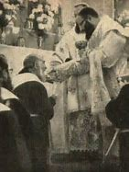
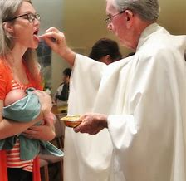
Reception of the Most Blessed Sacrament
All of these forms of reception of the Most Blessed Sacrament are valid and should not be repressed….without permission of the Archbishop.

Slide 11
Grace of the Eucharist
By reception of the Blessed Sacrament we are physically joined to Jesus.
This union preserves, increases and renews the Graces we receive in Baptism.
We can become more Christ like, if we allow the Grace to work within us.
We affirm that we are one in the Body of Christ, the Church.
We are called to go into the world with our renewed faith to live and evangelize all people.

Slide 12
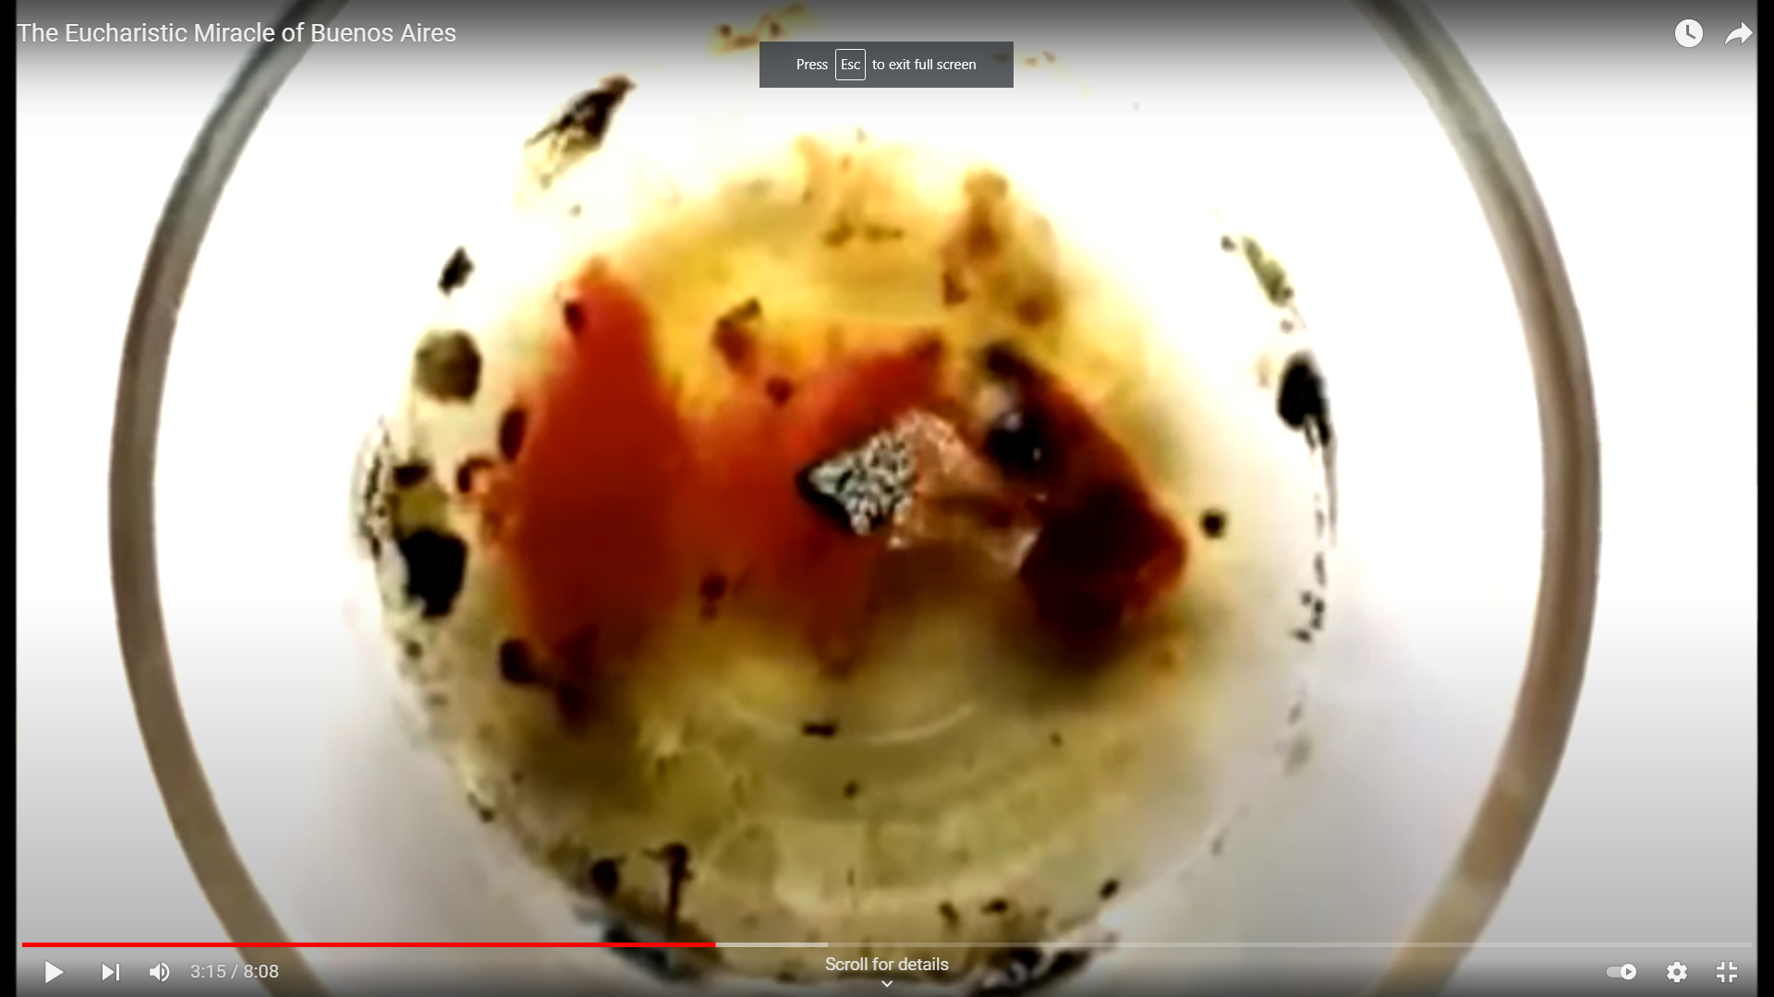
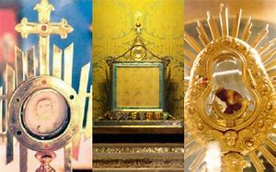
The Real Presence
Eucharistic Miracle of Buenos Aires
Scientific Proof of the Real Presence

Slide 14
10 Minute Break

Slide 16
Guidelines for Extraordinary Ministers of Holy Communion
The extraordinary minister of Holy Communion performs a great service to the Church, by distributing Holy Communion to God’s people on those occasions where there are an insufficient number of priests and deacons to distribute Holy Communion to the people present at the mass. It is an honor and a privilege to serve the Church in this capacity, and of course, requires careful preparation on the part of the extraordinary minister.
In each parish that makes use of extraordinary ministers, training and preparation is either done by the pastor, or, commonly, by an individual that he designates for that task. It is the purpose of this training to assist those individuals by providing some insight on the theological principles behind the Eucharist and the role of the extraordinary minister, the teaching and discipline of the Universal Church on that subject, the local norms for the Archdiocese of Atlanta, and some suggestions that may prove useful in their service to the Church. This training, however, is not a complete compendium on any of these topics, and, of course, the individual charged with preparing extraordinary ministers of Holy Communion will want to familiarize himself or herself in greater depth with these topics, especially through study and the cultivation of a strong personal devotion to the Most Holy Eucharist.

Slide 17
Introduction
The Archdiocese of Atlanta is blessed with many large, thriving parishes where the great number of communicants at Sunday mass, coupled with a limited number of priests and deacons, presents a real need for extraordinary ministers of Holy Communion. For that reason, when the permission to employ extraordinary ministers of Holy Communion was first given in 1971, the Archdiocese of Atlanta made use of it almost immediately. Thus, when the permission to use extraordinary ministers of Holy Communion was made universal with the instruction Immensae Caritiatis of 1973, the practice was already established in Atlanta. In that year, Pope Paul VI noted that in some places there was a shortage of ordinary ministers of Holy Communion, (priests and deacons) and provided for the institution of extraordinary ministers in certain circumstances. Indeed, since that time, extraordinary ministers have been of great service in many parishes of the Archdiocese. The presence of extraordinary ministers in the Church is a very new one in terms of the history of the Catholic Church, and is accommodated to particular circumstances of the modern world, and can be expected to develop as the Church has an opportunity to reflect upon this particular service offered to the Church.

Slide 18
What is an Extraordinary Minister?
In short, an extraordinary minister of Holy Communion is a lay person or religious who has been deputed by the bishop for a period of time, or by a priest or deacon for a single occasion, to assist the priest and deacon in distributing Holy Communion to the faithful on those occasions where a shortage of ordained clergy makes it impossible for them to distribute Holy Communion to all the faithful in a reasonable way. It is thus a privilege to which the Church invites certain individuals under given circumstances, and not a right.
…. it is to be looked at as the exercise of a function that is proper to the ordained priesthood, but which, of necessity, must be carried out by others. This highlights the extraordinary nature of this service, which, rather than being part of the structure of the Church, is instead tied to particular needs arising from the limited number of clergy.

Slide 19
When Extraordinary Ministers may be called upon
The General Instruction of the Roman Missal provides a basic description of the occasion when extraordinary ministers should be called upon:
“The priest may be assisted in the distribution of Communion by other Priests who happen to be present. If such Priests are not present and there is a truly large number of communicants, the Priest may call upon extraordinary ministers to assist him, that is, duly instituted acolytes or even other faithful who have been duly deputed for this purpose. In case of necessity, the Priest may depute suitable faithful for this single occasion. These ministers should not approach the altar before the Priest has received Communion, and they are always to receive from the hands of the Priest Celebrant the vessel containing the species of the Most Holy Eucharist for the distribution to the faithful. (GIRM 162) “

Slide 20
When Extraordinary Ministers may be called upon
We see four basic occasions when the Church calls upon the service of extraordinary ministers:
At mass, when the presider is physically unable to distribute Holy Communion;
At communion services when no ordained minister is available;
At masses where the great number of faithful prevents the priests and deacons from distributing Holy Communion to all of them;
To the sick when they are unable to be visited by a priest or deacon.
We will examine the procedures for distributing Holy Communion on each of these occasions.

Slide 21
Qualifications to Serve as an Extraordinary Minister
The faithful who are special ministers of communion must be persons whose good qualities of Christian life, faith, and morals recommend them. Let them strive to be worthy of this great office, foster their own devotion to the eucharist, and show an example to the rest of the faithful by their own devotion and reverence toward the most august sacrament of the altar. No one is to be chosen whose appointment the faithful might find disquieting. (Immensae Caritatis, 1, VI)
The Archdiocese of Atlanta has given some concrete expressions of these norms, namely that an extraordinary minister of Holy Communion, if married, be married within the Church, have received the sacrament of Confirmation, and be at least 16 years of age. In addition, it is necessary that the individual receive the certification of their pastor that they are properly qualified and trained. Additional expectations may be added by the individual parish.

Slide 22
Terminology for the Blessed Sacrament
The way we speak both reflects and shapes the way we believe, and so it is important that our language regarding the Blessed Sacrament reflect our understanding of its nature, and our faith in the real presence of Christ. Although all of Christ is present under each species, it is customary to refer to the host after consecration as either simply “the Host,” or “the Sacred Body.”
Likewise, the chalice may be referred to simply as “the chalice” or as “the precious blood.” The terms “bread” and “wine” should be used to refer to the bread and wine brought forward as gifts, but not to the consecrated species, which are no longer bread or wine, but the body and blood of the Lord.

Slide 23
Certification of Extraordinary Ministers
Because Extraordinary Ministers of Holy Communion serve the Church in a public capacity, it is necessary that an individual be certified before beginning service as an Extraordinary Minister. While instituted acolytes (usually seminarians and men preparing for the diaconate) become extraordinary ministers by virtue of their institution, other individuals require a specific commissioning.
Commissioning for an Extended Period
In most cases, Extraordinary Ministers of Holy Communion are certified for an extended period of up to three years. This is done by the Archbishop, upon request by the pastor of the parish. The pastor is responsible for selecting the individuals designated to serve and for verifying that they are in good standing with the Church, and that their selection would not scandalize the faithful.
A form is supplied to aid in this process (Appendix 2). After the individuals have been selected and trained, the pastor then submits a list to the Chancellor’s office. When they receive their certification, they are able to begin functioning as Extraordinary Ministers of Holy Communion until their certification expires.
It is advisable that, once the commission is granted, that they receive it through the Order for the Commissioning of Extraordinary Ministers of Holy Communion.4 (Book of Blessings, Chapter 63)

Slide 24
Preparation for Serving as an Extraordinary Minister
First of all, the minister should make sure that he/she is prepared to receive communion – that is in a state of grace, and having fasted before mass according to the norms of the Church.
Secondly, it is important to arrive at the church early, not only to sign in and find the assigned station, but also to take time in prayer before mass to prepare for service. It may be helpful to visit the Blessed Sacrament chapel, if separate from the main body of the church, in order to pray to our Lord present in the Blessed Sacrament.
While each parish will determine its own guidelines for the dress of extraordinary ministers of Holy Communion, extraordinary ministers should dress in a way that is dignified and shows respect for the Blessed Sacrament and the function they are carrying out.

Slide 25
Actions During the Mass
During the mass, the extraordinary minister sits with the rest of the faithful, and should participate fully in the mass, listening to the readings, and joining the community in prayer.
Approaching the Altar
Each parish will have slightly different norms for how the extraordinary ministers are to approach the altar to receive communion and their vessels. The general norm, however, is that they not approach the altar until after the priest has received communion. (GIRM 162)
Receiving Communion
The precise arrangement for extraordinary ministers to receive communion will vary from parish to parish. However, it should keep in mind the norms given by the Congregation for Divine Worship:
To avoid creating confusion, certain practices are to be avoided and eliminated where such have emerged in particular Extraordinary ministers receiving Holy Communion apart from the other faithful as though concelebrants.

Slide 26
Actions During the Mass
Receiving a Vessel
After receiving Holy Communion, the extraordinary minister will need to receive a vessel and proceed to the location where they will distribute Holy Communion. They are always to receive the vessel containing the Sacred Body or Precious Blood from the priest celebrant. (GIRM 162) It is important that they know where their station is, and, if extraordinary ministers need to pass to the rear of the church, that the ushers do not permit the aisles to become crowded until the extraordinary ministers are at their stations.

Slide 27
Manner of Distributing and Receiving Holy Communion
While the norm for the distribution of communion in the Roman Rite remains under one species and on the tongue, specific permissions have allowed communion under both species and communion on the hand to take place. It is important to consider each of these methods of receiving communion, because they each place particular burdens on the Extraordinary Minister.

Slide 28
Communion on the Tongue
First, we will consider communion under one species on the tongue. The communicant will generally make a sign of reverence (a bow is the norm in the United States), and then approach the minister standing. While standing is the norm in the United States, communion is not to be denied to those who prefer to approach by kneeling. The extraordinary minister takes the host and shows it to the communicant, saying “The Body of Christ.” Other words are not appropriate. It is best if the minister take the host between the thumb and the forefinger in such a way that they may place the host on the tongue by pressing down with the forefinger from above. This makes it easier to avoid contact with the tongue of the communicant.
The extraordinary minister should pay attention that no small fragments of the host fall to the ground. For this reason, the instruction Redemptionis Sacramentum states that “the Communion-plate for the communion of the faithful should be retained, in order to avoid the danger of the Sacred Host or some fragment of it falling” (Redemptionis Sacramentum, 93). Where the communion-plate is used, it is generally held by the server in such a way that it is under the Host at all times. If it is not used, it may be helpful to keep the host over the ciborium when possible.

Slide 29
Communion in the Hand
The practice of receiving communion in the hand, which is permitted in the United States by a special indult from the Holy See, places additional requirements on the Extraordinary Minister, because it is now necessary that they make sure that the Sacred Host is properly consumed, and that it is treated with reverence by the communicant.
Pope John Paul II describes this difficulty:
“In some countries the practice of receiving Communion in the hand has been introduced. This practice has been requested by individual episcopal conferences and has received approval from the Apostolic See. However, cases of a deplorable lack of respect towards the eucharistic species have been reported... This is in no way meant to refer to those who, receiving the Lord Jesus in the hand, do so with profound reverence and devotion, in those countries where this practice has been authorized.” (John Paul II, Dominicae Cenae, 11)

Slide 30
Communion in the Hand (cont)
Thus it is necessary for the extraordinary minister to observe the person receiving communion until he consumes the host. If they begin to walk off without receiving communion (as is sometimes the case with children who have not received proper catechesis or non-Catholic adults), it is important that the extraordinary minister follow that individual and either ask him to consume the host, or to retrieve it so that nothing untoward happens. It is important to note that the decision to receive communion on the hand is on the part of the communicant, and no one can compel them to receive on the hand or on the tongue.

Slide 31
Both Species
The permission to distribute communion under both species in certain cases was granted by Pope Paul VI with the instruction Sacramentali Communione in 1970, and with the publication of the revised GIRM in 2001. The responsibility for determining when it is appropriate to permit communion under both species rests with the diocesan bishop. In the Archdiocese of Atlanta, communion under both species is permitted at all masses, meaning that the individual priest celebrant may decide whether to offer communion under one or both species.
If communion is offered under both species, the ordinary minister of the chalice is the deacon; however, especially large celebrations may require the use of extraordinary ministers here, also. The only words used in distributing the Precious Blood are “The Blood of Christ.” In distributing the Precious Blood, it is important to avoid any danger of spillage. Care should be taken to make sure that the communicant has taken the chalice firmly before releasing it, but the extraordinary minister should, in ordinary circumstances, not hold on to the chalice while an individual receives communion. After distributing communion, the extraordinary minister should take the chalice, wipe the lip of it with the purificator, and rotate it slightly. If communion is offered under both species, the decision to receive from the chalice or not belongs to the individual communicant.

Slide 32
Communion from the Chalice Alone
Some individuals, for medical reasons, are unable to receive even a small particle of the Sacred Host. For this reason, it is permitted for individuals to receive Holy Communion only under the species (appearance) of wine.
Intinction
Although it is not customary in the Archdiocese of Atlanta, the Church also permits communion under both species by intinction. This decision is to be made by the priest celebrant – individual members of the faithful cannot chose to receive communion by intinction when it is not offered. In any case, “The communicant must not be permitted to intinct the host himself in the chalice, nor to receive the intincted host in the hand.”

Slide 33
Those Unable to Receive Communion
In most churches there will be some people who are unable to receive Holy Communion, or who choose not to. Someone might not be able to receive communion because they have not yet made their first communion, are not prepared through fasting, are not in communion with the Catholic Church, or are in a state of serious sin. There can also be many valid personal reasons why a person who is otherwise disposed might choose to abstain from Holy Communion. It is important not to judge the motivation for an individual not receiving Holy Communion.
Blessings
If the extraordinary minister determines that a person is seeking a blessing, it is appropriate that he respond with a prayer that is clearly distinct from the blessing given by a priest. It is recommended that he say, “May God bless you,” possibly while raising his hand. It is important that he not use the host in giving a blessing, and that he not touch the person with the fingers he has used for distributing Holy Communion, lest some particles be rubbed onto the individual.

Slide 34
Those Unable to Receive Communion
Denying Holy Communion
There are practically no situations when Holy Communion should be denied by an extraordinary minister.
If the extraordinary minister is unsure whether an individual is Catholic or has received their first communion, he should ask them or their parent, and if they reply that they are not, the extraordinary minister should let them return to their pew without receiving communion.

Slide 35
Returning the Blessed Sacrament to the Altar
After distributing communion, the extraordinary minister should return to the altar and hand the vessel to the priest or deacon. If the extraordinary minister is distributing the precious blood, it is permitted in the Archdiocese of Atlanta to consume whatever remains of the precious blood before returning to the altar.
If the vessel is empty, the priest celebrant may determine that the vessel be placed on the credence table, rather than the altar, for purification immediately or following mass.
If the extraordinary minister has been distributing the Sacred Host, he should take the opportunity to purify his fingers of any particles that may have clung to them. For this purpose, a small bowl of water is often provided at the credence table.

Slide 36
Accidents Involving the Blessed Sacrament
While every care should be taken to avoid accidents involving the Blessed Sacrament, the extraordinary minister should be prepared to respond to them should they occur. The most common sort of accidents involve a particle of the host or a portion of the precious blood falling on the ground or another object. If a particle of the host falls on the ground, it should be picked up and consumed. If for some reason it cannot be consumed (for example, if it has already been in an individual’s mouth who is unable to consume it), it may be dissolved in water and the water later poured down the sacrarium, however, it is best to contact a priest or deacon should this be necessary.
A greater difficulty is presented if some of the precious blood should fall to the ground. The extraordinary minister should insure that no one steps on the spot, perhaps by delegating an individual to guard it. A clean purificator could be used to mark the spot.
Then water should be brought and poured over the spot. It is important to note that when it is diluted with water to the point where it loses the appearance of wine, the Precious Blood ceases to be the Eucharist. The resulting water, however, should still be treated with respect, and, collected in a non-consecrated vessel (a lavabo bowl, for example) through the use of purificators; it should then be poured down the sacrarium.
If some of the precious blood should drop on an individual’s clothing or possessions, it should be treated in the same way, with due respect for the individual involved.

Slide 37
Purification of Vessels
The purification should be carried out by a priest, deacon, or instituted acolyte (usually a seminarian or deacon candidate) either after communion or immediately following mass.
Cleansing of Linens
The individuals who clean altar linens, in particular purificators, need to act with respect for the Blessed Sacrament. It is customary to soak all of the linens in water, so that any particles of the host or precious blood might be dissolved, and then pour this water down the sacrarium. It is not necessary to consume this water. After this process, they may then be washed normally, apart from other linens.
(Note that if the Precious Blood is spilled on any clothing, the same cleansing process should be used – or requested of someone who accidently receives a spill while receiving communion.)

Slide 38
Service to the Sick and Homebound
As an Extraordinary Minister of Holy Communion who brings Holy Communion to the sick, you may be called upon to make home visits, make rounds in a hospital or institutional setting or to conduct a Communion service in a chapel or other designated area in such a facility. It is important to be familiar with the Rites appropriate to all of these settings.
Receiving the Blessed Sacrament
The extraordinary minister will receive the Blessed Sacrament from the priest or deacon, sometimes within the context of mass. They should have a metal pyx in which to place the host(s), and a burse (a small pouch) on a cord in which to place the pyx. The cord should be placed around the neck, and then the burse (with the pyx inside) may be placed in a shirt pocket, or left hanging around the neck. The burse and pyx should not be placed in a purse, pants pocket, or other location.

Slide 39
Service to the Sick and Homebound (cont)
Traveling to the Sick or Homebound
Once the extraordinary minister has received the Blessed Sacrament, it is important that they go directly to the place where he is to distribute Holy Communion. It is never appropriate to take the Blessed Sacrament home for later distribution. These are considered grave matters by the Church. While on the way to distribute Holy Communion, it is important that the extraordinary minister avoid anything that might diminish his focus on the Blessed Sacrament, for example, engaging in unnecessary conversations or listening to the radio in the car.

Slide 40
Service to the Sick and Homebound (cont)
• If you are visiting the sick on weekdays, the same procedure for being dismissed at Mass can apply and is recommended.
• When bringing Communion to those who are sick, the hosts should be carried in a pyx.
• Before Mass begins, make sure the priest or deacon is aware that you will be dismissed and will need to have your pyx filled with the needed number of hosts from those consecrated at Mass. Procedures may vary slightly from parish to parish. Find out if you need to fill your pyx prior to Mass with the needed number of unconsecrated hosts or whether you should leave an empty pyx on the credence table before Mass begins which will be filled during Communion.
• After Communion but before the Prayer after Communion is said, the priest will invite you to come forward. He will place the pyx in your hands, say some words of dismissal to send you forth and may give you a blessing as you go on your way.
• Once you have received the pyx, you should immediately proceed from the church to your destination. Do not bow or genuflect as you leave since you are now carrying the sacred Body of Christ with you. You do not return to your seat.

Slide 41
Service to the Sick and Homebound (cont)
Great care should be taken in carrying the pyx. It is preferable that it be placed in a carrying case (burse), kept on your person or in a safe place.
• Avoid stopping to chat in the parking lot or stopping at a store or other place before going to your destination. It is acceptable to smile or greet someone as you go. However, be mindful of the most sacred presence you carry and the mission to which you have been called at that moment.. Your reverence for the Blessed Sacrament is a public witness to others. Don’t worry about offending people; people will notice and understand.
• If it is necessary to obtain the Blessed Sacrament from the Tabernacle, it is preferred to ask a Priest or Deacon to place the Host in a pyx.

Slide 42
Communion Service in a home
• Ask the family or sick person to have some things ready for the visit:
1. A table prepared with a linen cloth to put the pyx on;
2. A candle(s) which will be lit;
3. A small crucifix would also be appropriate.
4. A cup of water (in case the communicant may have difficulty swallowing the host)
In case these items are not available in the home when you visit, you might want to carry these things with you. If necessary, borrow a corporal from the parish so that you can put your pyx on it when you arrive.
• Consider bringing a bulletin from the parish.
• Be joyful and pleasant in greeting the sick person and other family members. Be sensitive and caring. Your pastoral concern and compassion is an important part of the healing ministry to which you have been called.
• Generally, for a home visit, it would be appropriate to use the rite for “Communion in Ordinary Circumstances.” This includes:
1. The Introductory Rites
2. The Liturgy of the Word
3. The Liturgy of Communion
4. The Concluding Rite

Slide 43
Communion Service in a home
• Invite family members or friends present to take part in the rites. Ask if someone might be interested in doing one of the readings or reading the intercessions. Readings can be chosen from those selections in the booklet. If it is a Sunday, make use of the reading(s) of the day.
• After the Gospel reading, you may want to provide a brief explanation of the reading. If you were dismissed from Mass, perhaps you might include some thoughts from the homily that you heard. Remember that the Word of God is an important source of nourishment for all of us and particularly for those who are ill and separated from the community.
• The General Intercessions are an important opportunity to pray for the sick person and all who are ill. The minister can also provide other appropriate prayers and might also invite those present to offer their own intentions.
• For Communion, it is important for the minister to show the host to those present using the appropriate words provided in the rite, “Behold the Lamb of God…” It is helpful for the minister to say the response with the sick person (“Lord I am not worthy…”) since they may have difficulty remembering. (Use responses from Third Edition of the Roman Missal 2011)
• Administer Communion to the sick person and any others present who are to receive. Be mindful of the sick person’s condition. Sometimes they might only be able to receive a small piece of the host and you may need to break it. Also, it might be helpful to have a cup of water handy in case they need to take a drink after receiving to help them consume the host.
• Allow some quiet time after the person has received Communion for prayer. This also provides the minister with an opportunity to pray for the sick person.
• After the concluding prayer, spend some time chatting or talking to the person you are visiting. Perhaps bring a bulletin from church to give them and keep them current on what is happening in the parish. The pastoral concern and interest you show will be most welcomed by the sick person and family members. They still want to feel connected to the community even though they are absent.
• Be ready to listen. Beyond the Eucharist which they have received, this may be the greatest gift you can give them.

Slide 44
Communion Service – returning hosts
• If you should have hosts remaining after you have made your rounds, you should bring them back to the church immediately so that they can be returned to the tabernacle. Notify the priest or deacon that you have hosts to be returned to the tabernacle. In some parishes, the Extraordinary Ministers are permitted to take and return hosts to the tabernacle. Follow the instructions of the parish. Please note: the hosts should never just be left alone in the sacristy or other place. You should always stay with the Blessed Sacrament until the hosts can be properly reposed.
• If it is not possible to return the hosts to the tabernacle, remaining hosts may be consumed but may never be reserved in the home.
• Once the pyx is empty, it should be purified. If there is no priest or deacon available to purify the pyx when you return, use good judgment and, if necessary, purify the pyx yourself. If you are using your own personal pyx, it should also be purified after each time you use it.

Slide 45
Practical Maters
Interview form for new Eucharistic Ministers
Review the names of Eucharistic Ministers with the Pastor to ensure that he is in agreement.
Submit names and dates to …. for certificates
Renewal should take place every 3 years.

Slide 46
Appendix 2 – Extraordinary Minister Interview Form
This form is provided as a sample to assist parishes in interviewing candidates to become Extraordinary Ministers of Holy Communion
Name _____________________________________________
Address _____________________________________________
Phone _____________________________________ Cell / Home / Work
E-mail _________________________________________
Are you 18 yrs or older? Y / N If under 18, what is your age? _______
Which Sacraments have you received (circle)
Baptism Yes No
First Penance / Reconciliation Yes No
First Communion Yes No
Confirmation Yes No
Marital Status
Single ____ Engaged ____ Married ____
Separated ____ Widowed ____ Divorced ____
If married or engaged, is this or will this be your first marriage? __________
If married or engaged, will this be your first spouse / fiancée’s first marriage? ________
If married or engaged, were you or will you be married by a Catholic bishop, priest, or deacon in a Catholic Church? _________________

Slide 47
Prayer after one receives the Eucharist

Slide 48
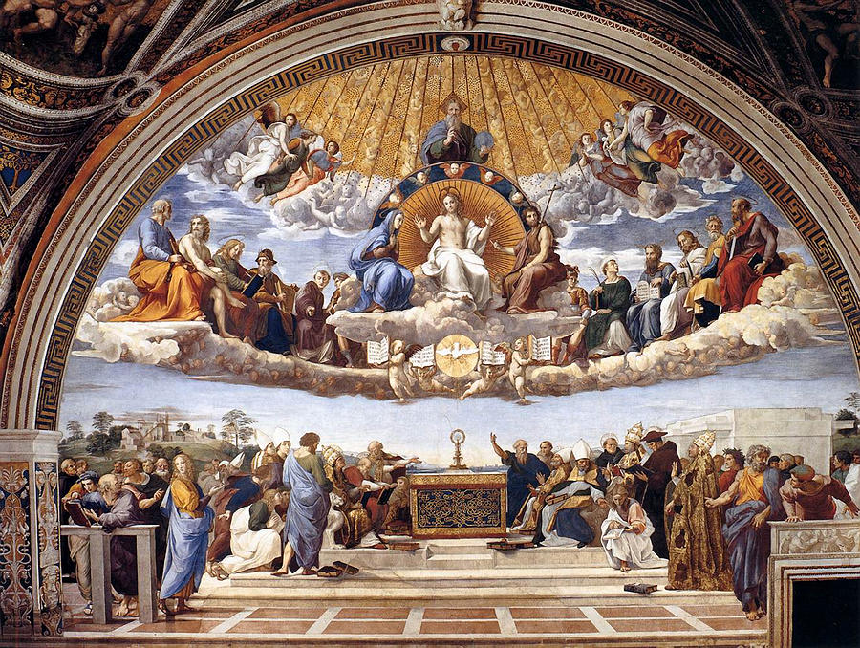
The Mass “Behind the Veil”

