Slide 1
Church Financial Review
March 2021

Slide 2
Office Collections
(Admin. Staff)
Ministries and Church Activities
(Staff and Volunteers)
Offertory and Collections
(Ushers)
Primary Sources of Revenue
Count all funds collected and deposit to Bank
Money Counters
Recordkeeper (PSFS)
Bookkeeper (PSA)
Business Manager
Record information based on documentation
Lay Treasurer
Pastor/ Administrator
Finance Council
Third Party Review of Records
Notes:
As noted on this slide, you will find which are the parishes sources of revenue. Primary source will likely always be from offertory (and thus safeguarding these funds and following approved count procedures is of vital importance); however internal controls should always be in place for all sources of funds (no matter the amount). Following internal controls will help safeguard the financial assets of the Church, protect employees and volunteers, and avoid scandal.
This slide also shows different “roles” within the parish’s activities, and the importance of having a segregation of duties. When the parish has proper segregation of duties, it decreases the likelihood of fraud, and makes detection of issues easier.
Though I am not going to go into that much detail about segregation of duties, I will point out that this is one of the top findings we find in a lot of parishes.

Slide 3
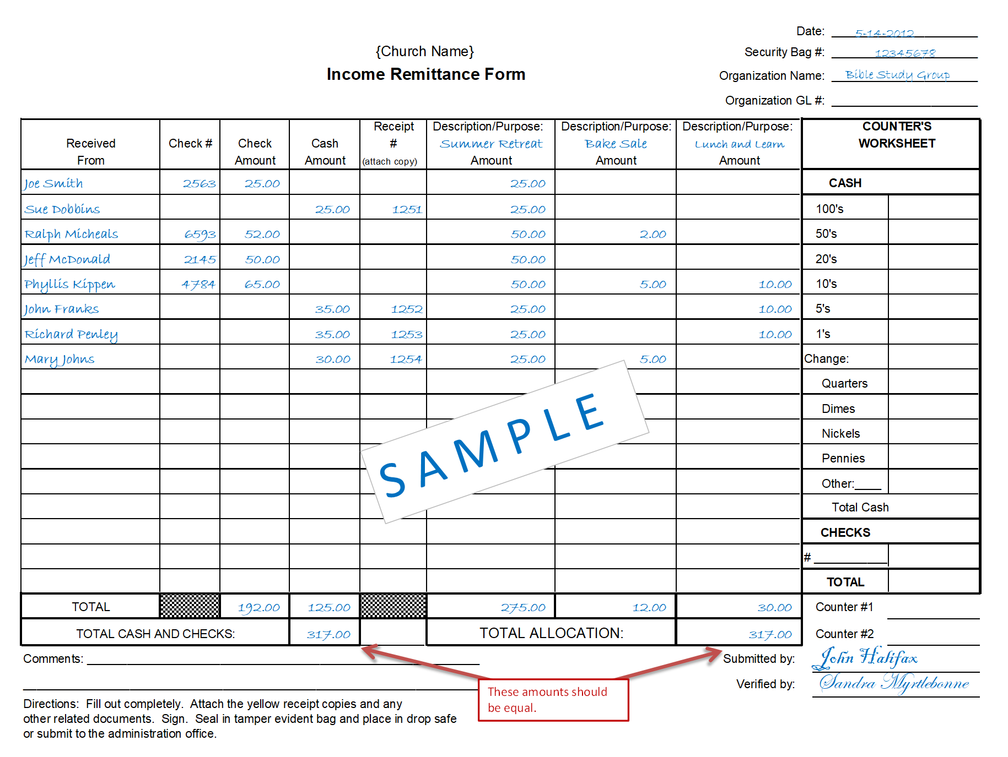
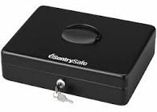
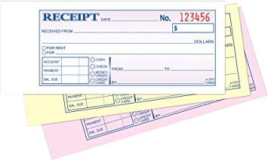
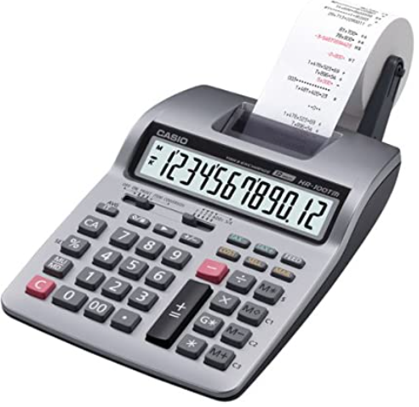
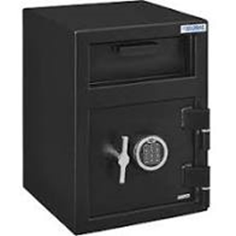
Segregation of Duties – It protects you and others
VS
Financial Review
Notes:
When one individual has access to assets as well as the responsibility for maintaining the accountability of those assets, or complete control over a parish’s processes, this can expose the parish to risk (loss of funds, incorrect financial statements, etc.). It protects them.
The parish should design the work and related tasks so that the work of one person is independent of or serves as a check on the work of another. This reduces the risks of undetected errors and limits the opportunities to misappropriate assets, or conceal intentional misstatements in the parish’s financial statements.

Slide 4
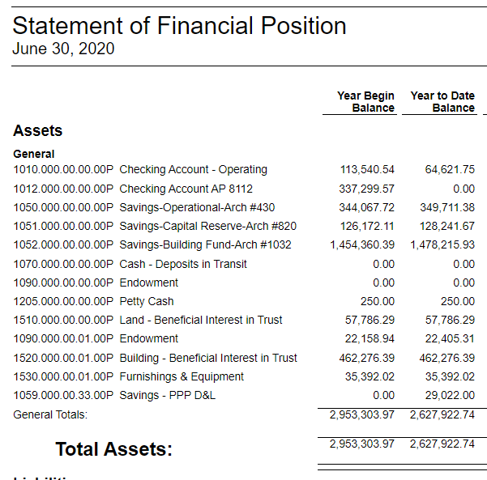
What is a Reconciliation?
A Reconciliation of financial statements is an accounting process that compares two sets of records, one internal the other external, to ensure figures are correct and in agreement. The general ledger is the master set of accounts that aggregates all transactions recorded for a business or non-profit.
Example:
Should reconcile to the Bank Statement
Should reconcile to the Archdiocese’s D&L Statement
Should reconcile to the North GA Endowment Statement

Slide 5
Primary Systems of Record
ParishSOFT Accounting (PSA) - Accounting system used to manage the income, expenses and other financial activities of the parish.
ParishSOFT Family Suite (PSFS): Donor management system that includes offertory management, RE Student data and Ministry participation.
Notes:
A system of record is a data management term for an information storage system (basically it is the database that is the authoritative date source for information for parishes.
ParishSoft Family Suite – this system is where you record your parish’s families

Slide 6
Church Financial Review Dashboard
Reference: Church Financial Review Checklist
Weekly | Monthly | Quarterly | Annually
Count = Deposit | Contributions/Collections (including Online Giving) | Endowment Accts | FYE Statements to Parishioners
 | Financial Statements and Journal Entries | Religious Ed (R/E) | Contribution letters
 | Checking Acct and D&L Reconciliations | Preschool | AoA Certification Letter
 | Payroll | Misc. Income | Annual Budget
 | Mass Stipends | Exchange Accts | Inventory of Gift Shop
 |  | Columbarium
Notes:
This dashboard shows the financial reviews that the Pastor and another 3rd party should perform at each parish. However, note that during this training we will also show other reviews that should be completed by the business manager.

Slide 7
Weekly Reviews
Count Sheets
(Counters)
ParishSOFT Accounting Deposit Report
(Bookkeeper)
Batch on ParishSOFT Family Suite
(Recordkeeper)
Bank Transaction Receipt
(Bookkeeper)
Documentation to be reviewed:
Bag Log
Count sheets (individual and summary)
Bank Transaction Receipts
Deposit Register from PSA
Contribution Listing from PSFS
Oversight responsibility:
Business Manager
Pastor
3rd Party Reviewer
IMPORTANT: All reports should be signed/dated by each reviewer on the totals page.

Slide 8
Case Study
Catholic Church is a small parish that had the following collections on December 2020:
 | 12/05 | 12/06* | 12/31
Offertory |  | $575.75 | $200
2nd Collection |  | $30.00
Mass Stipends | $30 | $20
Religious Ed | $50 |  | $100
Online Giving |  |  | $200
On 12/06 there were two Masses and one second collection, while on 12/31 there was only one Mass and no second collection.
Online giving through Vanco was made available to parishioners on 12/31.

Slide 9
Weekly Review
Bag Log - Reference Exhibit 1, page 1.
Primary Responsibility of Review: Business Manager
Reviewer ensures two ushers, who are background and credit checked, have evidenced dual control of funds when dropping the collection bags in the drop safe. There should also be two counters, verifying that all bags were obtained from safe.
Ensures all bags for collections were collected as expected, and no Masses were missed.
Verifies the parish’s calendar. Were there any ministry activities where funds should have been deposited and included as part of the count?
Individual Count Sheets = Summary Count Sheets - Reference Exhibits 2 and 3, pages 2 - 4
Primary Responsibility of Review: Business Manager
Ensures two counters, who are background and credit checked, have dually signed each individual count sheet
Lead counter and another counter have signed the summary count sheets.
Verifies totals on Individual Count Sheets match Summary Count Sheet, including the amounts by denomination.
Ensures all Mass collections were collected as expected, and no Masses were missed.

Slide 10
Weekly Review
Summary Count Sheet = Bank Transaction Receipt = Deposit Register- Reference Exhibits 4, page 5.
Primary Responsibility of Review: Business Manager and Pastor
Total deposit should match count records. Proceeds from collections were deposited to parish’s bank account.
Cash and Check values match – counters should deposit all monies intact and not exchange bills/checks. Example: If the Bank’s Transaction Receipt shown in the Exhibit reported $15 in $1.00 bills and $10 in $5 bills it is likely that someone has substituted bills.
Review that funds collected were properly posted on ParishSOFT Accounting (PSA) by reviewing the Deposit Register
Count Sheet = ParishSoft Contribution Report - Reference Exhibits 2 and 5, pages 3 and 6.
Primary Responsibility of Review: Business Manager
Review the ParishSOFT Family Suite Contribution Report by batch (Exhibit 5, page 6). If possible, pull an Excel version of the report and sort by Envelope Cash, Loose Checks, Envelope Checks, Loose Cash, and match to count sheets (Exhibit 6, page 7).

Slide 11
Weekly Review
Miscellaneous Receipts - Reference Exhibits 7, 8 and 9, pages 8 - 13.
Primary Responsibility of Review: Business Manager
Count sheets for miscellaneous receipts are also reviewed as per the process above; however, other important considerations are noted:
Not all collections need to be posted on ParishSOFT Family Suite.
Reviewer should monitor receipts issued to track if all monies were properly submitted for deposit.
The parish should complete two deposits: One for Mass collections (includes second collections), and a second deposit for miscellaneous receipts. The only exception is if the Bank does not provide a Cash-In receipt that details the cash (broken out by denomination) and checks deposited. If so, the parish should complete four deposits: Mass collections (1 deposit for cash and 1 deposit for checks), and Miscellaneous Receipts (1 deposit for cash, and 1 for checks)
Third Party Reviewer:
It may be cumbersome for the parish to request that the Lay Treasurer or a member of the Finance Council review on a weekly basis ALL items reviewed by the business manager (i.e., bag log, individual count sheets, etc.) However, it may be recommended that on a Monthly or Quarterly basis they audit this process by requesting a random count sample (i.e., request count records for the Masses celebrated on the 3rd weekend of January).

Slide 12
Church Financial Review Dashboard
Reference: Church Financial Review Checklist
Weekly | Monthly | Quarterly | Annually
Count = Deposit | Contributions/Collections (including Online Giving) | Endowment Accts | FYE Statements to Parishioners
 | Financial Statements and Journal Entries | Religious Ed (R/E) | Contribution letters
 | Checking Acct and D&L Reconciliations | Preschool | AoA Certification Letter
 | Payroll | Misc. Income | Annual Budget
 | Mass Stipends | Exchange Accts | Inventory of Gift Shop
 |  | Columbarium
Notes:
This dashboard shows the financial reviews that the Pastor and another 3rd party should perform at each parish. However, note that during this training we will also show other reviews that should be completed by the business manager.

Slide 13
Monthly Review
A. Monthly Contributions/Collections
Responsibility to prepare reports: Bookkeeper/Recordkeeper
Responsibility to review: Business Manager, 3rd Party Reviewer, and Pastor
Documentation to be reviewed:
Monthly Bank Statement
Online Giving Reports
Contribution Listing from PSFS (reporting YTD fund balances)
Month-End Income Statement from PSA (reporting YTD balances)
Month-End Balance Sheet Accounts (to review balances of Second Collections and Mass Stipends)
Audit and Batch Report from PSFS
IMPORTANT: All reports should be signed/dated by the Pastor/Administrator and a member of the Finance Council with financial skills on the totals page.

Slide 14
Monthly Review
Monthly Contributions/Collections
General Ledger (ParishSoft Accounting) against Monthly bank statement
Review Deposit Register from PSA to the monthly bank statement. Any discrepancies need to be investigated. Compare Exhibit 10 to Exhibits 4 and 9.
Why were the collections from 12/31 not reflected in the December Bank Statement?
Online Giving Reports against monthly bank statement
Print a summary for remittances from your online vendor on a monthly basis.
Did all deposits get posted to the parish’s bank account?
Who has access to edit the bank account information on the online giving software?
Notes:
OLG – Vendors should be deposited in gross and fees charged separately.
Vendors should be approved by Arch.

Slide 15
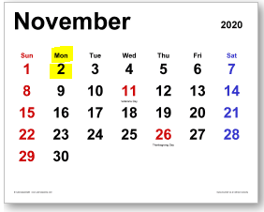
Monthly Review
Monthly Contributions/Collections
Note: Detailed instructions on how to complete these reconciliations are now available!
Reconciliation between PSFS and PSA:
Contribution Listing from PSFS should be compared to:
Fiscal YTD Income Statement from PSA (for offertory, building fund, and all other revenue related accounts)
Month-End Balance Sheet Accounts (primarily to review second collections, and Mass stipend balances)
Discrepancies between PSFS and PSA must be reconciled and properly documented. See Exhibit 11, page 16.
The #1 reason why the systems do not match is because of timing differences
ParishSOFT Family Suite Contributions are posted as of the date the funds are GIVEN to the church. In the case of online giving, it is when the transaction is initiated by the donor. | ParishSOFT Accounting Funds are posted as of the date the funds are DEPOSITED in the bank account. This normally occurs a few days AFTER the funds have been collected at the Church.
Example: Offertory was collected October 31, 2020 which is a Sunday.
PSFS will report the donation as of 10/31/2020 | PSA will report the donation as of the day of deposit, which would likely be Monday 11/01/2020. Thus, the offertory will not be reported in the October’s Offertory Account on the I/S.
Notes:
Review Audit and Batch Report from PSFS
Audit Report: Shows you _________________
Have all batches closed? ___________________________
Not all money that the church receives is a donation. PSFS is a donor management area. There could be money that comes in that is not a donation, such as a rebate from Office Depot – it shouldn’t be included in PSFS, but will be part of your deposit.
Donuts – money from donuts do not need to be recorded, this is not a donation. If I sponsor donation of donuts that is a true donation. There is money that is not going to be recorded in PSFS.

Slide 16
Other items that may affect the reconciliation between PSA and PSFS include but are not limited to: 1. Donations/Monies/Funds that may or may not be posted on PSFS; however, they are recorded on PSA: These may include donations from 401Ks, IRAs or Donor Advised Funds, matching contributions from employers (if posted to PSFS all these should be recorded as non-tax deductible). Rebate checks from the Archdiocese, financial institutions or other companies. 2. Stock donations may have different values on PSFS and PSA - Record keeper should record stock donation at gift value, which is mean value on donation date. Bookkeeper should record revenue at gift value and compare gift value to liquidated value, as reported on broker confirmation, and book the difference as a gain or loss on sale of stock. It is important to highlight that ALL funds collected, even from mail-ins, should flow through the count.
Monthly Review
Monthly Contributions/Collections
Weekly Review

Slide 17
Monthly Review
Monthly Contributions/Collections
PSFS Batches:
A batch is a group of contributions (for example, the Archdiocese recommends that each offering from a given Sunday be posted on PSFS as one batch). Batch processing is a method of entering contributions into PSFS in groups rather than one at a time.
Batch data entry provides internal checks and controls that help minimize the risk of fraud and loss. One effective fraud prevention control is the Close Batch feature. As a security measure, a good accounting practice is to close batches in a timely manner. After a batch is closed, its data is secure because the system locks the batch and prevents anyone from making further changes to the contributions in it.
Review on a monthly basis:
Audit Report: This report captures the actions of any user who makes changes to a batch’s details or to the transactions within an open batch. Note: as noted above, after a batch is closed, it cannot be reopened. All users are prevented from modifying a closed batch’s details and contents. See Exhibit 12.
Log-on to PSFS and review that the business manager has closed all committed/open batches that have already been reviewed.
Notes:
Review Audit and Batch Report from PSFS
Audit Report: Shows you _________________
Have all batches closed? ___________________________
A batch is a group of contributions. Entering contributions in batches (groups) helps speed up data entry especially when you have a lot of contributions to get into your system. The batch-entry process also provides critical internal controls that can help safeguard your contributions and reduce the risk of fraud.

Slide 18
Monthly Review
B. Financial Reports - Reference Addendum #1
Responsibility to prepare reports: Bookkeeper
Responsibility to review: Business Manager, 3rd Party Reviewer, and Pastor
Documentation to be reviewed:
Balance Sheet (also known as Statement of Financial Position) – compare actual month to last year’s balances
Income Statement by Department (also known as Statement of Activities) – compare Actual to Budget
Income Statement by Department (also known as Statement of Activities) – compare Actual to Last Year’s Balances
Monthly Manual journal entries, including write-offs.
IMPORTANT: All reports should be signed/dated by the Pastor/Administrator and a member of the Finance Council with financial skills on the totals page.
Notes:
Pull Reports for each parish specifically.

Slide 19
Monthly Review
C. Checking Account and D&L Reconciliations:
Responsibility to prepare reports: Bookkeeper
Responsibility to review: Business Manager, 3rd Party Reviewer, and Pastor
Documentation to be reviewed:
Month-End Bank Statement
Month-End DA and Loan Statements
PSA’s Bank Reconciliation Reports (for operating account and DA accounts)
PSA’s Monthly Check Register
PSA’s Monthly Detailed Trial Balance
Documentation from online banking evidencing that deposits in transit have been deposited.
IMPORTANT: All reports should be signed/dated by the Pastor/Administrator and a member of the Finance Council with financial skills on the totals page.

Slide 20
Monthly Review
Checking Account and D&L Reconciliations
Month-End Bank Statement:
Review bank credits – credits should be from parish-initiated deposits and from online giving vendor only. Do not share the parish’s bank account with others.
Review electronic debits – approved electronic debits include payroll, online giving fees, and payments to Catholic Mutual. Usage of online bill pay is discouraged as it may circumvent controls.
Month-End Archdiocesan DA and Loan Statements
Review debits/credits to balances. All debits/credits to Archdiocesan accounts should be approved by Pastor.
Were loan payments missed or misapplied? Is there any past due interest?

Slide 21
Monthly Review
Checking Account and D&L Reconciliations
PSA’s Bank Reconciliation Reports (for operating account and DA accounts)
A Bank Reconciliation helps you identify any unusual transactions that might be caused by fraud or accounting errors, and the practice can also help you spot inefficiencies.
Things to review in a bank reconciliation include:
Tie balances per the bank reconciliation to the bank statement.
Cleared Checks: Look for unusual items, duplicate payments, checks made out to employees or volunteers (that may need to be processed through payroll). Check for checks made out to CASH.
Cleared Journal Entries: Look for unusual items. Journal entries may include Payroll deductions (including taxes), payroll fees, online giving fees, bank statement interest income, void checks, bank service charges or fees, and checks that were deposited but are now returned as NSF.
Uncleared checks: Checks outstanding greater than 90 days should be researched and re-issued if necessary.

Slide 22
Monthly Review
Checking Account and D&L Reconciliations
PSA’s Monthly Check Register (Detailed)
This report shows all checks issued and is sorted by vendor paid.
Look for duplicate and unusual payments.
PSA’s Monthly Detailed Trial Balance – Primary Responsibility: Finance Council
Within the period range selected, for each account, this report displays the beginning balance, a line for each transaction, the total debits and credits and the ending balance.
Deposits-in-Transit
Obtain documentation from online banking evidencing that deposits in transit have been deposited.

Slide 23
Monthly Review
C. Payroll Reports:
Note: This review should take place each time payroll is processed and thus is likely a bi-monthly process.
Documentation to be reviewed:
Approve all timesheets, and ensure the hours reported by each employee match the Pre-Processing payroll register.
Ask business manager to confirm that there have been no changes to the W-4 and G-4s of employees. If an employee has changed their withholdings, make sure they are accurate in the pre-processing payroll register.
Sign/date the pre-processing payroll register, documenting your approval to process payroll.
Review, sign/date the post-processing payroll register to ensure no changes were made to the pre-processing payroll register.

Slide 24
Monthly Review
D. Mass Stipends:
IMPORTANT: Mass Stipends that have been collected should be paid to the priests after the scheduled Mass has been celebrated.
Documentation to be reviewed:
Report of Mass intention dates and donation amount. This information should be used to determine payment for fulfilled intentions each month and support for the mass stipends check request.
Archdiocesan guidelines on Mass Stipends:
The Pastor has the obligation to offer one Mass for the people of the parish on every Sunday and Holy Day of Obligation for which he should not receive a stipend.
The priest should receive the stipend given for the Mass he celebrates unless the priests of the parish agree among themselves to divide their stipends in a different way. In that case, visiting priests should still receive the stipends for the Masses they celebrate.
A priest is only allowed to retain one Mass stipend per day (except on Christmas Day).
Please reference “Guidelines on Mass Stipends in the Archdiocese of Atlanta for more information.

Slide 25
Quarterly Review
Reference: Church Financial Review Checklist
Weekly | Monthly | Quarterly | Annually
Count = Deposit | Contributions/Collections (including Online Giving) | Endowment Accts | FYE Statements to Parishioners
 | Financial Statements and Journal Entries | Religious Ed (R/E) | Contribution letters
 | Checking Acct and D&L Reconciliations | Preschool | AoA Certification Letter
 | Payroll | Misc. Income | Annual Budget
 | Mass Stipends | Exchange Accts | Inventory of Gift Shop
 |  | Columbarium
Notes:
This dashboard shows the financial reviews that the Pastor and another 3rd party should perform at each parish. However, note that during this training we will also show other reviews that should be completed by the business manager.

Slide 26
Quarterly Review
Endowment, Exchange Accounts, and other Liability Accounts
Endowment accounts should be reconciled to the statement quarterly. The amounts reported on the statement should match the Quarter-End Statement of Financial Position.
Exchange Accounts and Other Liability Accounts should be reconciled to a detailed list or what represents the balance. For example: Second collections, Other Parish Ministries, Sports, Archdiocese debt.
Miscellaneous Income:
Reconcile to the PSA revenue account. For example – multiply the number of participants times the rate to get the total revenue deposited. Adjustments (for example, tuition waivers, scholarships, etc) should be reasonable. Events should use tickets so expected sales (tickets sold times rate) can be compared to actual revenue.
Weekly | Monthly | Quarterly | Annually
Count = Deposit | Contributions/Collections (including Online Giving) | Endowment Accts | FYE Statements to Parishioners
 | Financial Statements and Journal Entries | Religious Ed (R/E) | Contribution letters
 | Checking Acct and D&L Reconciliations | Preschool | AoA Certification Letter
 | Payroll | Misc. Income | Annual Budget
 | Mass Stipends | Exchange Accts | Inventory of Gift Shop
 |  | Columbarium | R/E Letters

Slide 27
Quarterly Review
Religious Education Revenue and Preschool Revenue
Documentation to be reviewed:
Detailed listing/report of students from the student database (i.e., ParishSoft Religious Education Module, Excel, etc)
Detailed listing/report of students listing amounts paid, rate, scholarships given, multi-child discounts, and staff discounts.
Account balance report from ParishSoft Accounting.

Slide 28
Quarterly Review
Religious Education
ParishSoft Family Suite – Religious Education Module | Excel Tracking ALL payments for ALL students | PSA Religious Education Revenue Account Balance
Listing of Students (Pull Sacraments List) | Listing of Students reporting payments received, and any payment waivers (review Pastor Approval). | Review Detail from RE Income Account
A similar process should be completed if the Parish has a preschool, using the system of records utilized by the preschool to track registrations and payments. See Exhibit 13.

Slide 29
Quarterly Review
Columbarium
Reference: Protocol for the Development of Columbaria Niches Spaces or Memorial Gardens in the Archdiocese of Atlanta.
Perpetual Care Fund
For projects completed prior to June 30, 2017 – 14% of total revenue received for the niche must be deposited in a perpetual care fund with the Catholic Foundation of North Georgia.
For projects approved after June 30, 2017 - A minimum of $700 per niche is required for perpetual care. Prior to the start of construction, the parish/mission is required to establish a perpetual care fund at the Catholic Foundation of North Georgia (CFNGA) and contribute an initial amount equal $100 times the number of niches in the construction plan. Once construction is complete, the parish/mission will contribute $100 times the number of niches to the perpetual care fund. The remaining $500 per niche should be funded no slower than $100 per niche each year on the anniversary of the completion of construction. Distributions from the perpetual care fund will commence after the full $700 per niche has been contributed. The parish/mission will execute a Letter of Credit from the Deposit & Loan Fund to ensure funding of the perpetual care fund.

Slide 30
Quarterly Review
Columbarium
Reconcile on a quarterly basis:
Reconcile HMIS Reports to General Ledger on PSA
For example, the parish sold 5 niches for $5,000 each, then HMIS and PSA should report $25,000 in revenue. Print this reconciliation, sign/date it and have a third party review it.
Approve Check Request to fund the Perpetual Care Fund, meeting the guidelines noted on prior slide and any other approvals reported in the Archbishop’s Columbarium approval letter.

Slide 31
Annual Reviews
Reference: Church Financial Review Checklist
Weekly | Monthly | Quarterly | Annually
Count = Deposit | Contributions/Collections (including Online Giving) | Endowment Accts | FYE Statements to Parishioners
 | Financial Statements and Journal Entries | Religious Ed (R/E) | Contribution letters
 | Checking Acct and D&L Reconciliations | Preschool | AoA Certification Letter
 | Payroll | Misc. Income | Annual Budget
 | Mass Stipends | Exchange Accts | Inventory of Gift Shop
 |  | Columbarium

Slide 32
Annual Reviews
FYE Statement to Parishioners:
Publish FYE financial statements to parishioners. Information should tie to PSA reports, or footnotes should explain any discrepancies with PSA. Primary Responsibility: Business Manager
Contribution Letters:
Contribution letters must be sent by January 31st. Select an individual that does not have edit access to PSFS to prepare and review the letters. If a parishioner has a question on their statement, they must contact an individual that does not have edit access to PSFS so that they can research the answer. Primary Responsibility: Third Party
AOA Certification Letters:
Certification Letter is due to the Archdiocese by September 31st. Primary Responsibility: Pastor, Business Manager and Finance Council
Annual Budget:
Follow Archdiocesan guidelines to prepare budget of revenues and expenses. To be completed by mid-May. Primary Responsibility: Pastor, Business Manager and Finance Council

Slide 33
Annual Reviews
Inventory of Gift Shop (if applicable):
Inventory of gift shop should be conducted at least annually, though spot checks should be performed sporadically. Primary Responsibility: Business Manager

Slide 34
Other ParishSOFT Family Suite Reports
Contribution 3 Year Summary
Contribution Monthly, Quarterly, Yearly Comparison Report
Contribution By Dollar Range – can provide information for specific funds or all funds
Family Summary Report

Slide 35
Contacts
Name | Position | Phone # | E-Mail
Michael Warren | Director of Financial Services | 404-920-7411 | mwarren@archatl.com
Holly Orsagh | Internal Audit Manager | 404-920-7906 | horsagh@archatl.com
Neema Mollel-Mbonika | Senior Accountant (Billing Questions) | 404-920-7406 | nmollel@archatl.com
Patrick Warner | Parish Systems Manager | 404-920-7410 | pwarner@archatl.com
Susan Shirley | Parish Systems Administrator | 404-920-7408 | sshirley@archatl.com
Carolina Figueroa | Parish Technical Support Specialist | 404-920-7424 | cfigueroa@archatl.com
Marquita Richburg | HR Manager | 404-920-7483 | mrichburg@archatl.com

