Slide 1
Proclaiming the Word of God
Training for Lectors in the Archdioceses of Atlanta
https://www.wofdigital.org/the-mass-engage-mini-course/season:1/videos/mass-mini-series-6

Slide 2
Lectors Prayer
Lord, thank You for this opportunity to gather together in Your name. We thank You also for the gifts You have given us through the Holy Spirit.
We have accepted Your call to proclaim Your word and ask Your continued help and guidance in our endeavors. Help us to recognize the importance of Your call to be a lector. May we be prepared within ourselves, in order to present Your word in a meaningful and understanding manner.
Through the gifts of the Holy Spirit, give us the confidence and ability to follow Your call.
Amen

Slide 3
The Role of the Lector in the Church
From the very beginning, Christians have gathered together to hear the word of God, and,
from the very beginning, there have been individuals entrusted with the task of reading the
word. That service to the church has developed over the course of time, but it is good to
know something about the history of the lector in order to better understand the role
in the Church today.

Slide 4
Minor Orders
From the earliest times, the church had a number of minor orders which were responsible for performing various ministerial functions in the liturgy. These orders (porter, lector, exorcist, and acolyte) were ordained to carry out a specific ministerial function in the Mass.
Over the course of time, these minor orders came to be used only as stages of preparation of candidates for the priesthood, and so most parishes would not have ordained lectors.
In 1972, as a part of the post-conciliar liturgical renewal, Pope Paul VI suppressed the minor orders and replaced them with two ministries: Lector and Acolyte.

Slide 5
Non­ Instituted Lectors
Not all lectors are formally instituted. In fact, many parishes will not have a single instituted lector and very few will have an adequate number to proclaim the readings. In response to this pastoral reality, the General Instruction on the Roman Missal (GIRM) provides the following:
“In the absence of an instituted lector, other laypersons may be commissioned to proclaim the readings from Sacred Scripture. They should be truly suited to perform this function and should receive careful preparation, so that the faithful by listening to the readings from the sacred texts may develop in their hearts a warm and living love for Sacred Scripture. (GIRM 101)”
Thus we see that when instituted lectors are not present, it is appropriate for other lay peopleto read the readings at mass. Thus, most parishes have programs for non-instituted lectors, who are scheduled to read at the various masses throughout the week.

Slide 6
Qualifications to serve as a Lector
The two requirements for lectors listed in the General Instruction are that they be “truly suited to perform this function” and that they “should receive careful preparation.”
In the Archdiocese of Atlanta, in order for an individual to be regarded as “truly suited,” it is required that they be a fully initiated Catholic living in Communion with the Church. Thus, a lector should have received both First Holy Communion and Confirmation,and should not be living in an invalid marriage or in any other state of grave sin.
Being “truly suited” also implies the necessary native talents to serve as a lector.
A lector should have completed the Archdiocese training for a safe environment and be current in Virtus certification.

Slide 7
Remote Preparation
One of the tasks of the lector, in preparation for their work in proclaiming the Word of God is to develop a knowledge and familiarity with scripture.
Secondly, this preparation consists in learning the vocal techniques of proclamation, so that they may make use of the resources of the human voice in such a way that the intonation, pitch, pacing, and timbre of their speech may most effectively convey the content of the sacred writings.
The lector's task is to help the gathered assembly to encounter God in His Word. Thus, everything that the lector does during mass should aid the faithful to focus on the scripture, and not on themselves.

Slide 8
The Role of the Lector at Mass
The role of the lector at mass is described in the General Instruction of the Roman Missal, numbers 194-198. However, this description is intended to present the role of an instituted lector.
Regarding non-instituted lectors, the GIRM simply states that “in the absence of an instituted lector, other laypersons may be commissioned to proclaim the readings from Sacred Scripture.” (GIRM 101)

Slide 9
The Liturgy of the Word
Approaching the Ambo
  As number 260 of the GIRM notes, the readings should be proclaimed from the ambo or a lectern. If the lector is not seated in the sanctuary, then they make a profound bow to the altar before they enter it. If the lector is already in the sanctuary, they proceed directly to the ambo. (cf. GIRM 274).
The Readings
  In reading the scriptures, the lector should have the goal of communicating God's Word with His people. This means that their comportment should aid all present to focus on the Word of God and to appreciate its full depth of meaning. Thus, the lector's physical posture should express the dignity of the Word, and should help the faithful to focus on the Word itself, rather than on the lector's movements or gestures. Of principle importance is the way in which the lector makes use of their voice in the proclamation of the Word.

Slide 10
The Liturgy of the Word
Procession into the Sanctuary
  In parishes where the Lector enters the Sanctuary with the celebrant, they should enter in front of the deacon / priest and behind the crucifer and luminaries (if present). As part of the process, they would normally reverence (bow) towards the Altar but are not expected to genuflect facing the tabernacle as that action would have typically taken place prior to the beginning of Mass.
Recession from the Sanctuary
  In those cases where lectors are seated in the sanctuary, they may also process out of the church together with the celebrant. In this case, the lectors precede the celebrant assembling at an appropriate location at the foot of the altar, where they bow together with the celebrant, and withdraws in a manner similar to the Entrance Procession (GIRM 186).

Slide 11
Training Lectors
In the course of a lector training program, it is necessary to introduce the lectors to a number of different skills important for their service.
They need to learn how to approach the ambo, the technique of speaking into a microphone if one is used, the importance of the Word of God, techniques for preparation, and especially the techniques of proper proclamation.
While the Archdiocese does not have any mandatory requirements for the training of lectors, the “Proclaim the Word!” lector training program is made available by the Archdiocese of Atlanta in order to better prepare lectors for their service to the Church.
A successful lector training program will not only teach lectors the mechanics of their work, but will also help to impart the necessary proclamation skills, while at the same time building in the lector a deeper appreciation for the Word of God and their own Catholic faith.
A strong lector program can also form the parish lectors into a community where each member supports the other in faith.

Slide 12
A simple exercise on the importance of emphasis
Repeat the sentence above, placing emphasis on each word in sequence each time…
I ….. didn’t know she kissed him
I didn’t …… know she kissed him
I didn’t know…… she kissed him
I didn’t know she….. kissed him
I didn’t know she kissed …….him

Slide 13
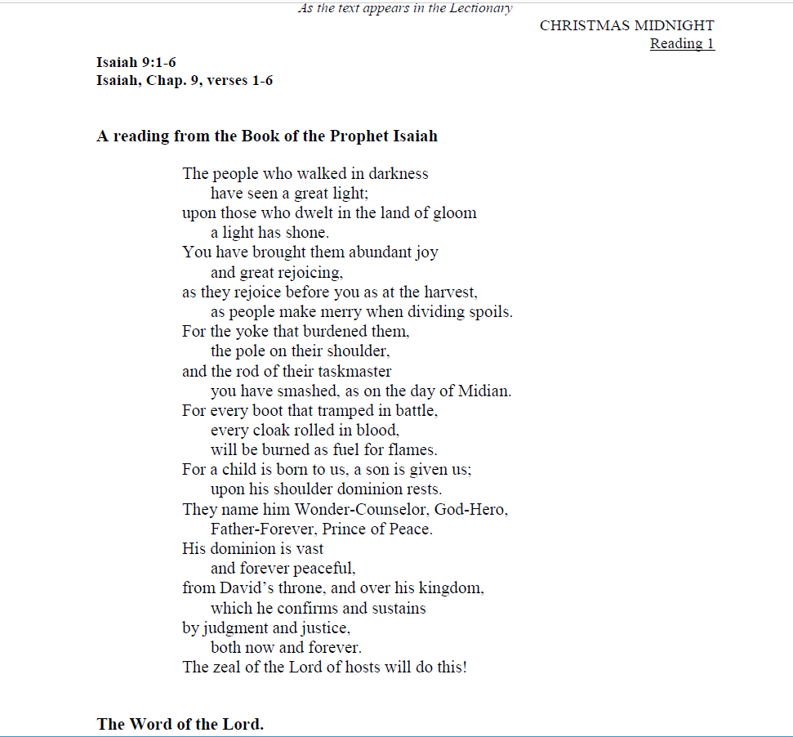

Slide 14
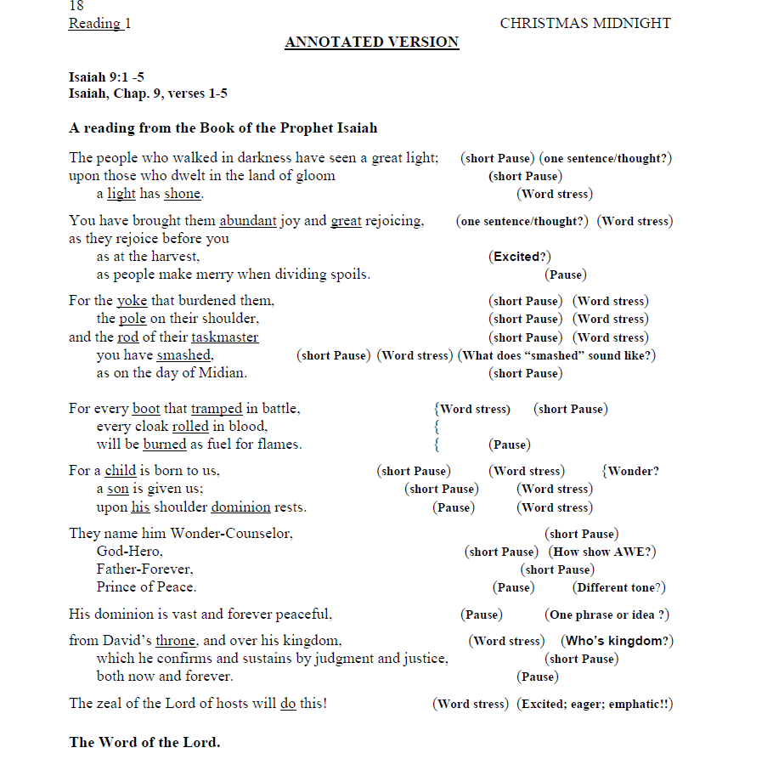

Slide 15
Other Functions of the Lector at Mass
The General Instruction calls for the lector to assume the functions of other ministers when they are not present at a particular mass. There are two particular cases that call for this auxiliary function, and they each impose different tasks and requirements on the lector.

Slide 16
Other Functions of the Lector at Mass
The Psalm
As the psalm serves to “[foster] meditation on the word of God.,” (GIRM 61) the lector's recitation should take this feature into account, allowing the psalm to assist the congregation in achieving a greater appropriation of what they have heard in the first reading.
The Prayers of the Faithful
In this case, the lector should take into consideration the difference between the intentions and the readings from scripture. As the intercessions are prayer texts, they should be prayed by the lector, and not simply read.

Slide 17
Lectors and other Ministries
The celebration of the mass calls for the use of many different ministries. In general, it is preferable that a different person perform each distinct liturgical function so that one individual does not perform multiple roles in the same mass. If, however, a shortage of properly trained individuals makes this impossible, it is permissible to have one individual perform multiple roles.

Slide 18
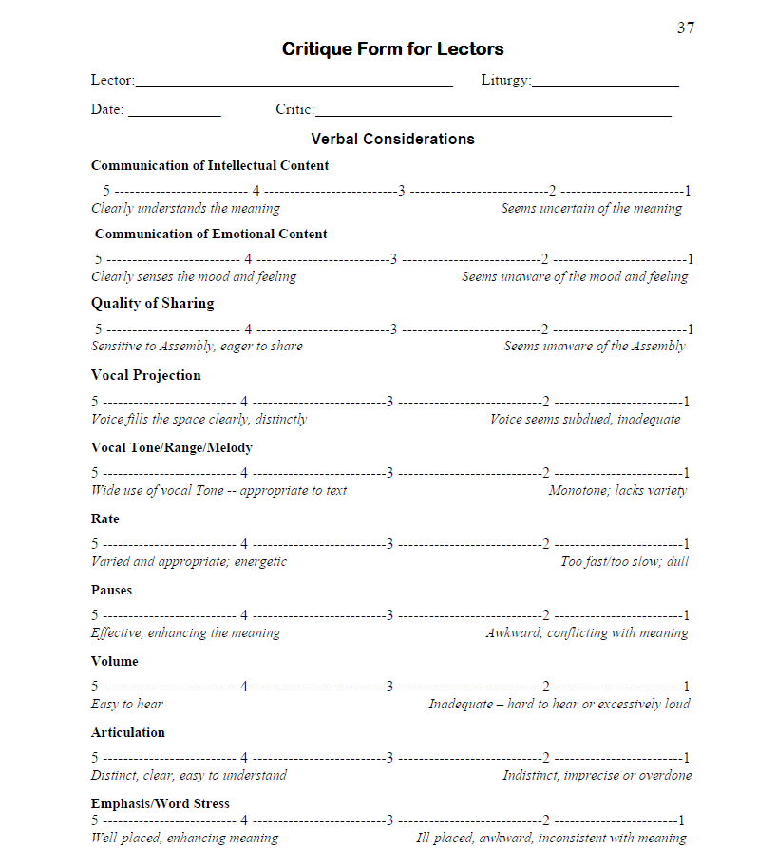
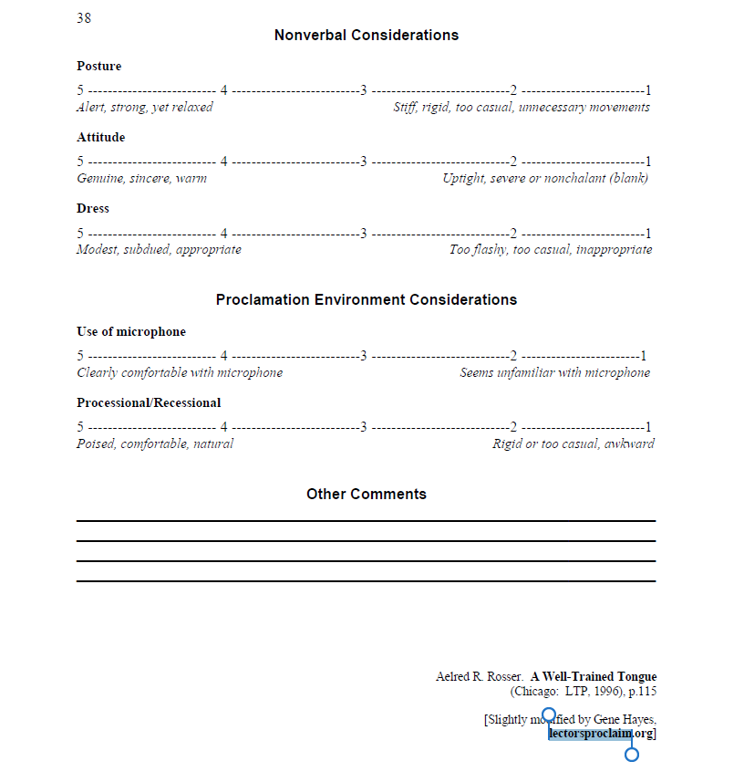

Slide 19
THANK YOU FOR YOUR ASSISTANCE AT THE SACRED LITURGY
By your witness to Christ in His Church, you will touch many lives.

